Slide 1
Combining Social Media Storytelling With Web Archives
from a large collection to a small story

Slide 2
Lesson Goals
Introduce Social Media Storytelling
Discuss how to manually gather story resources from Archive-It
Discuss how to automatically gather story resources from a web archive collection using the Dark and Stormy Archives (DSA) Toolkit
Detail how to visualize these resources using storytelling tools

Slide 3
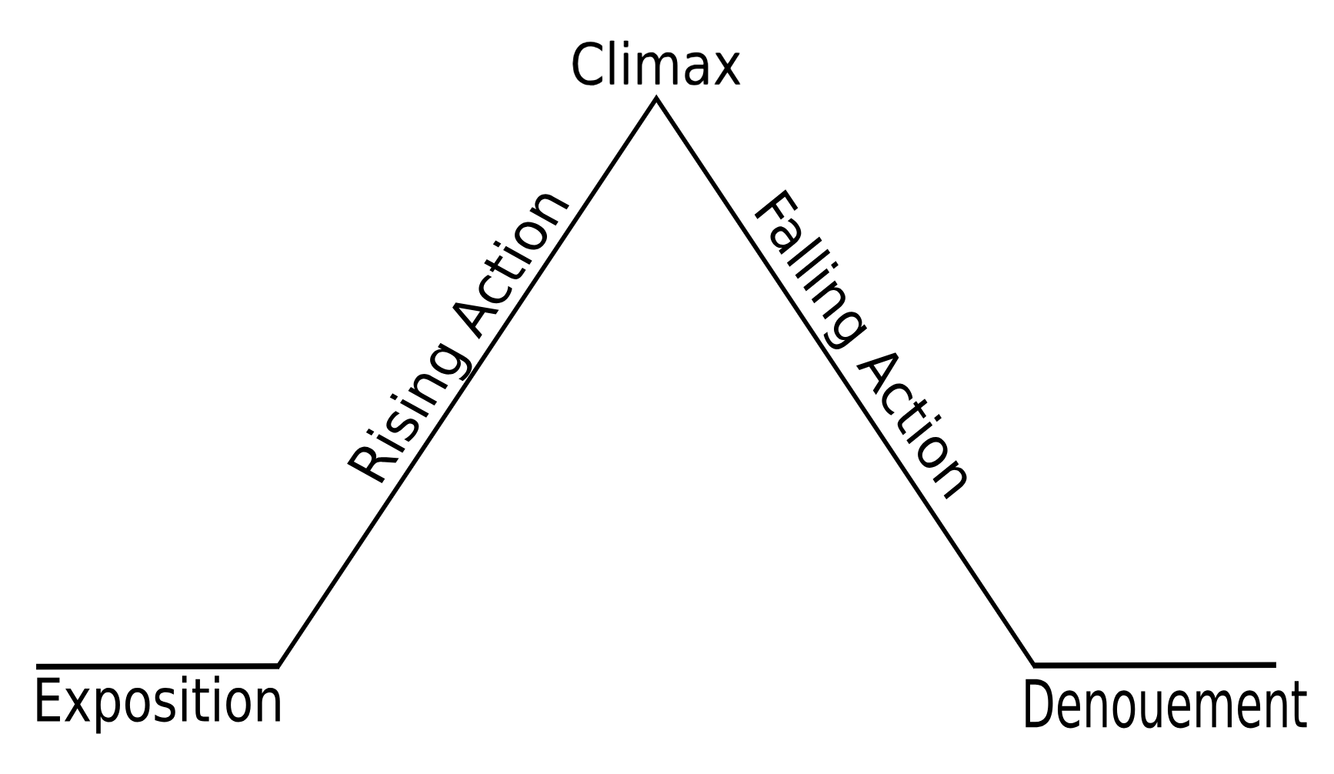
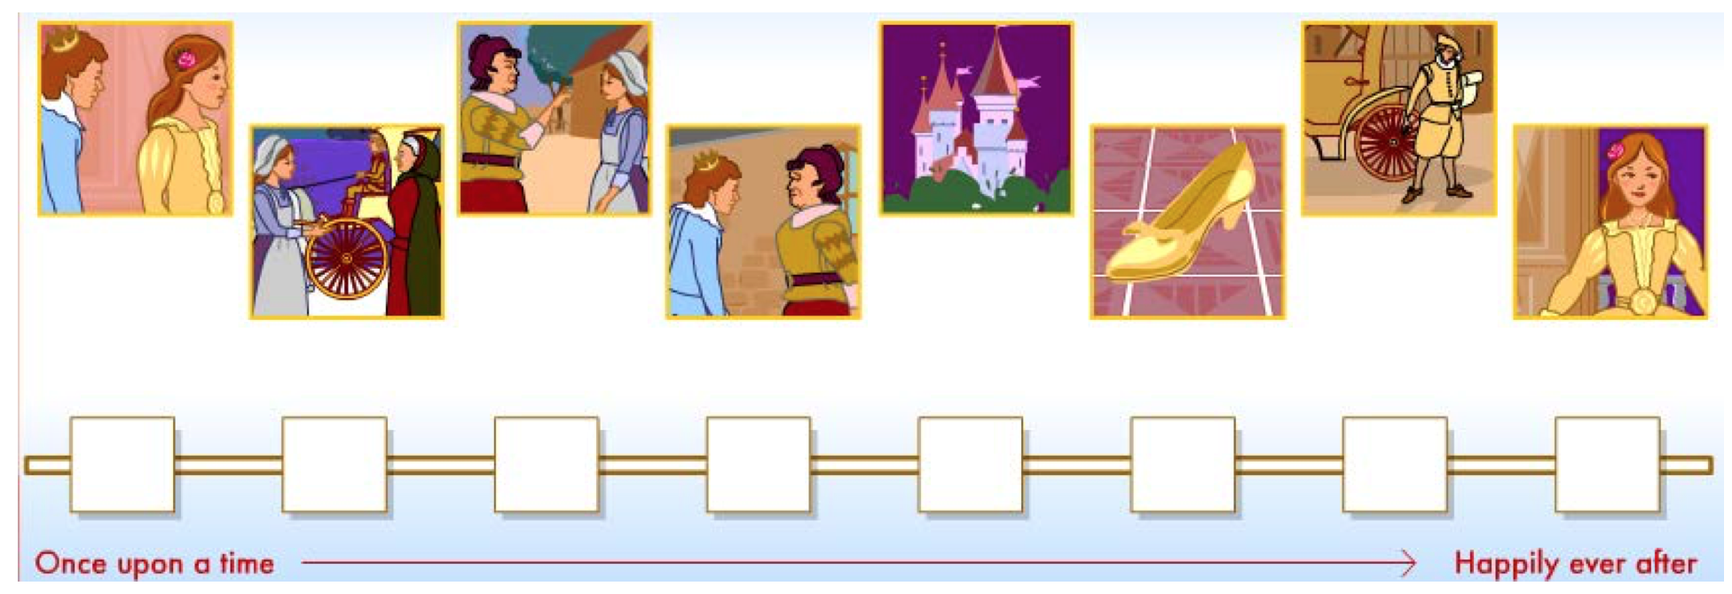
Storytelling in Literature
Story elements: setting, characters, sequence, exposition, conflict, climax, resolution
See:
http://www.learner.org/interactives/story/
https://en.wikipedia.org/wiki/Dramatic_structure

Slide 4
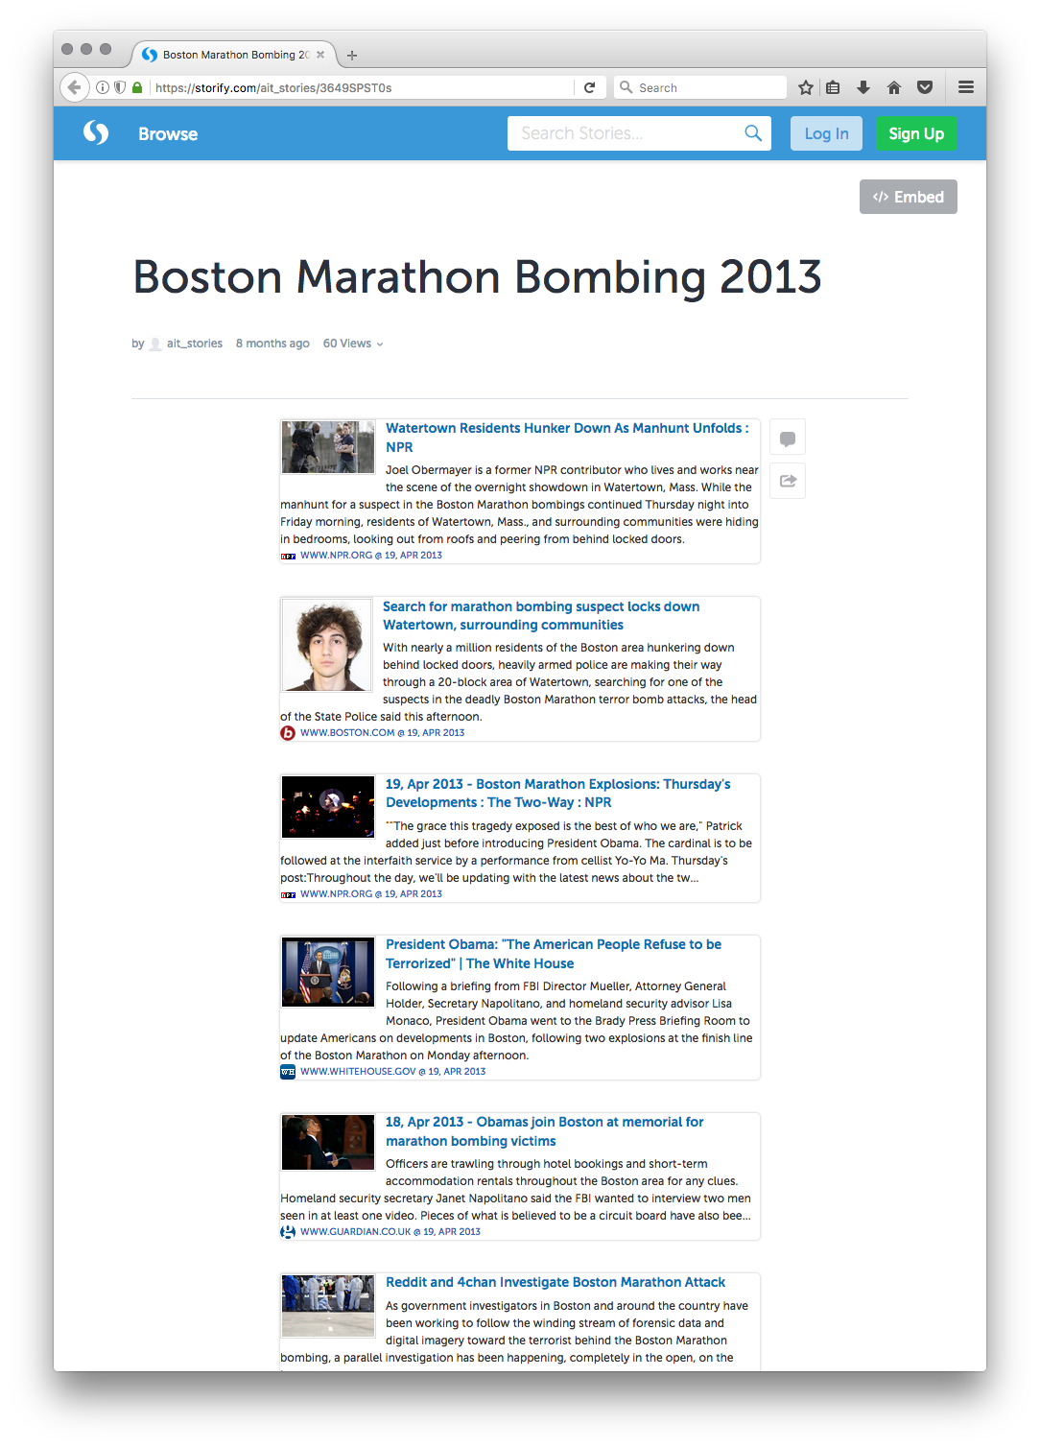
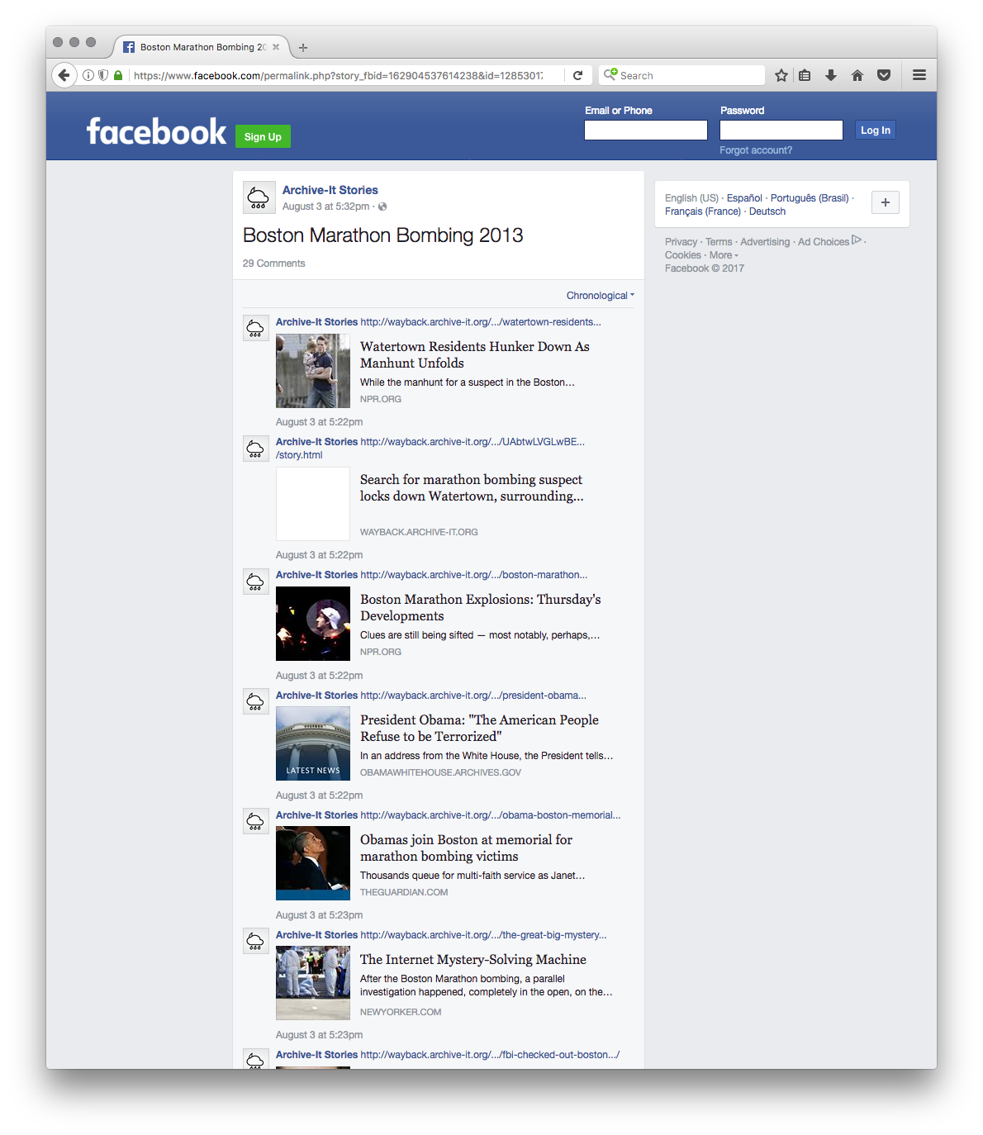
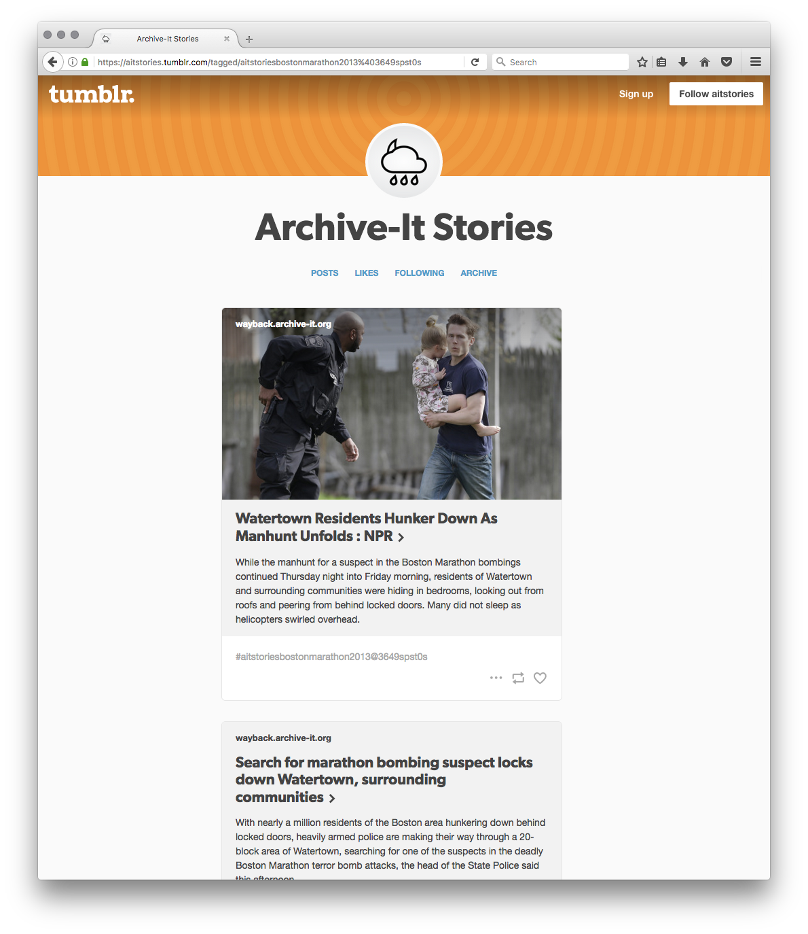
Storytelling in social media
A sampling and arrangement of web resources for summarization.

Slide 5
Social Cards
URIs can be difficult for people to comprehend
Instead we use Social Cards as the surrogates for storytelling
Social cards provide a title, small text snippet, and striking image from the web page behind a URI
Social cards are summaries of web pages

Slide 6
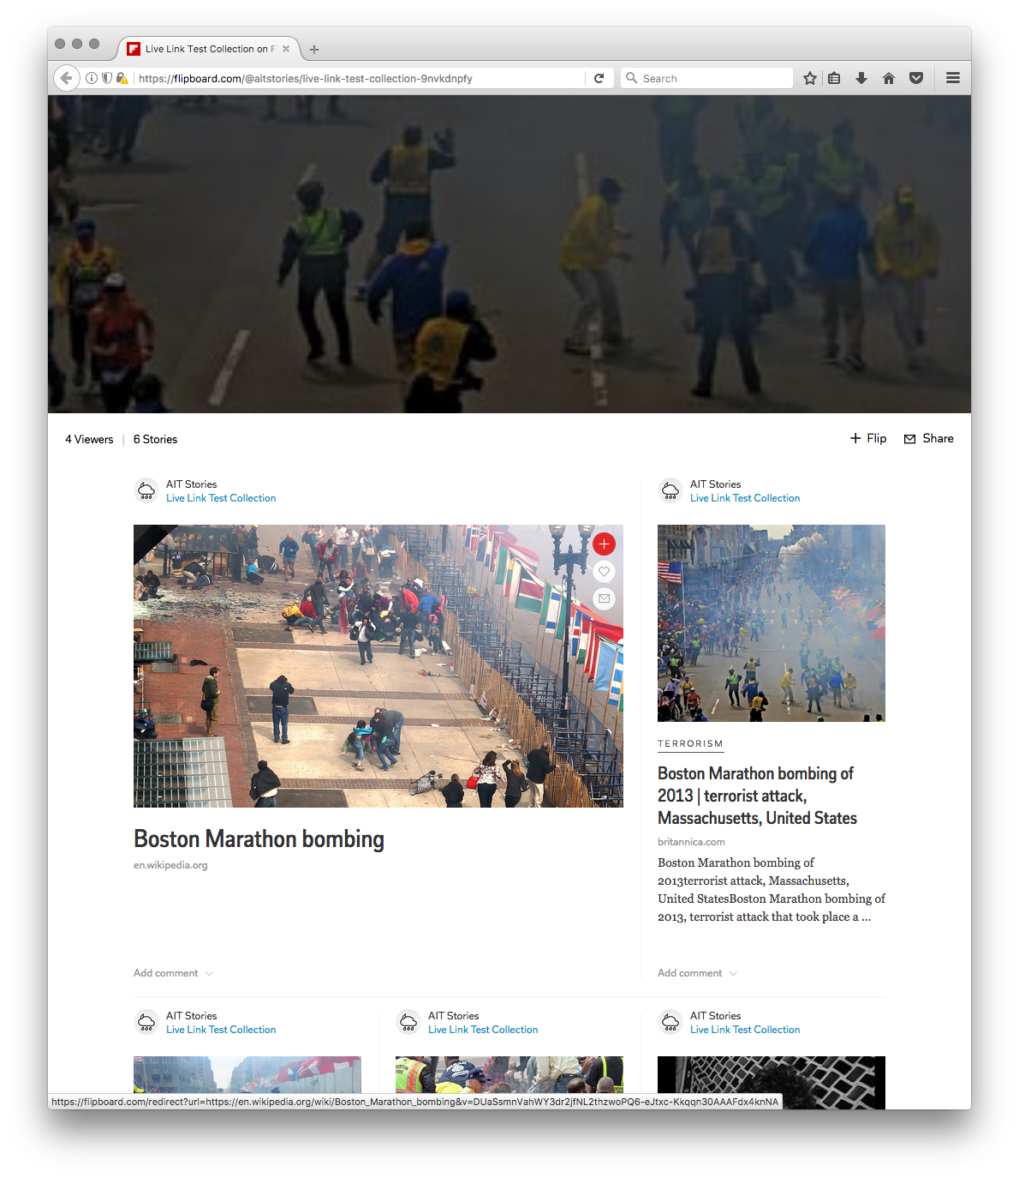
Social Cards in Groups Are Used For Storytelling
We tell stories using social cards in groups
Social cards contain the same information in the same place each time
This makes it easier for a person to compare them and scan for text and images
Stories are summaries of collections of web pages

Slide 7
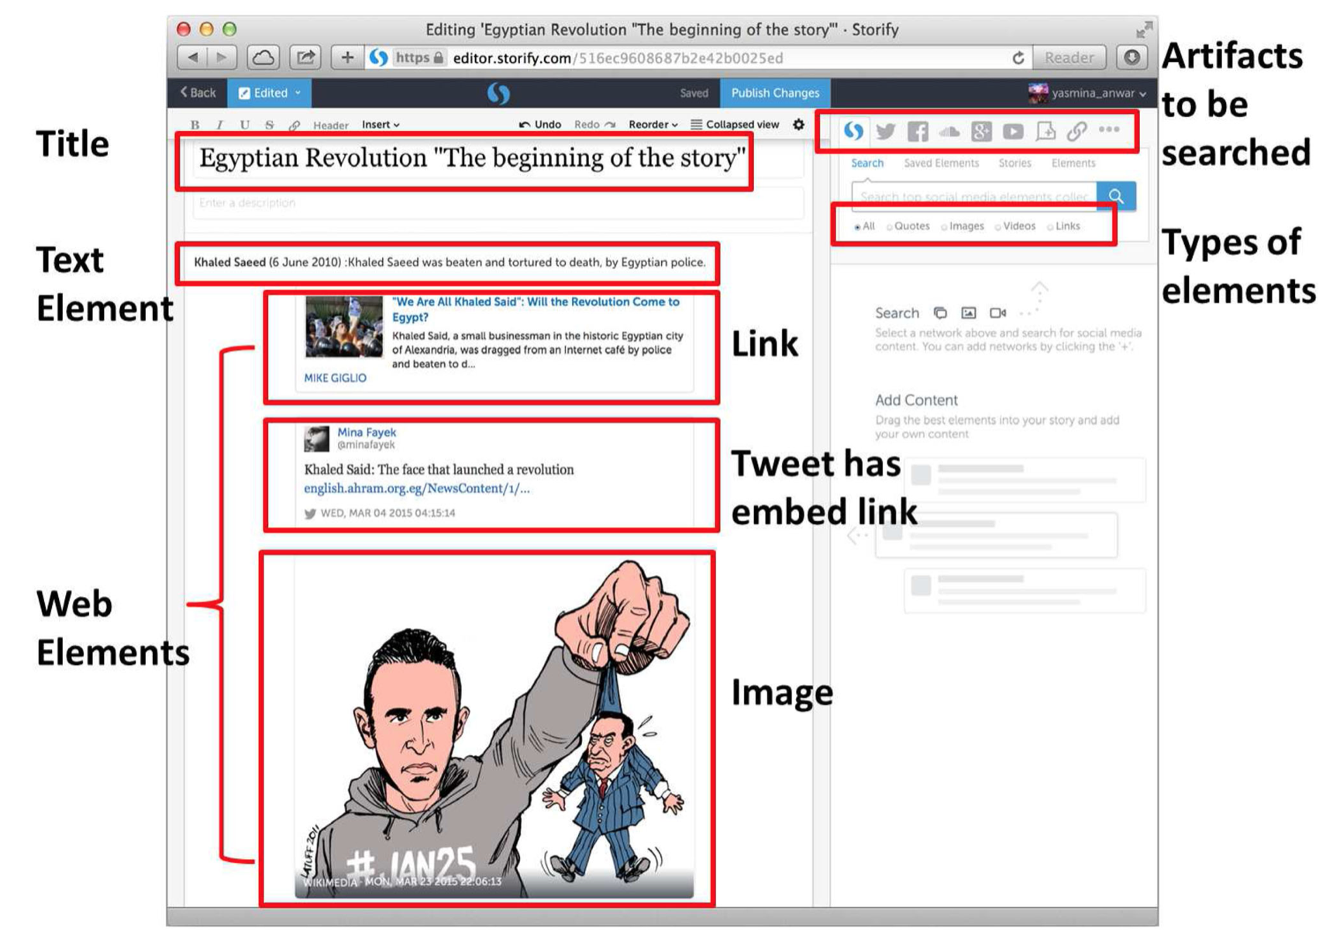
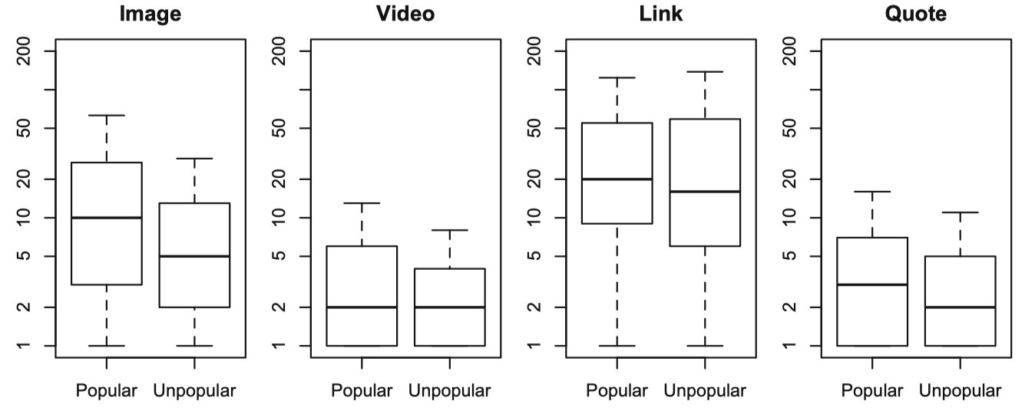
Popular Stories
AlNoamany discovered that popular social media stories
Contain around 28 elements
Contain mostly social cards
This means that they are mostly links to other content
Because they are mostly links, popular stories help users by reducing a topic down to a small number of items – a summary
See: IJDL 2016, https://doi.org/10.1007/s00799-016-0185-3

Slide 8
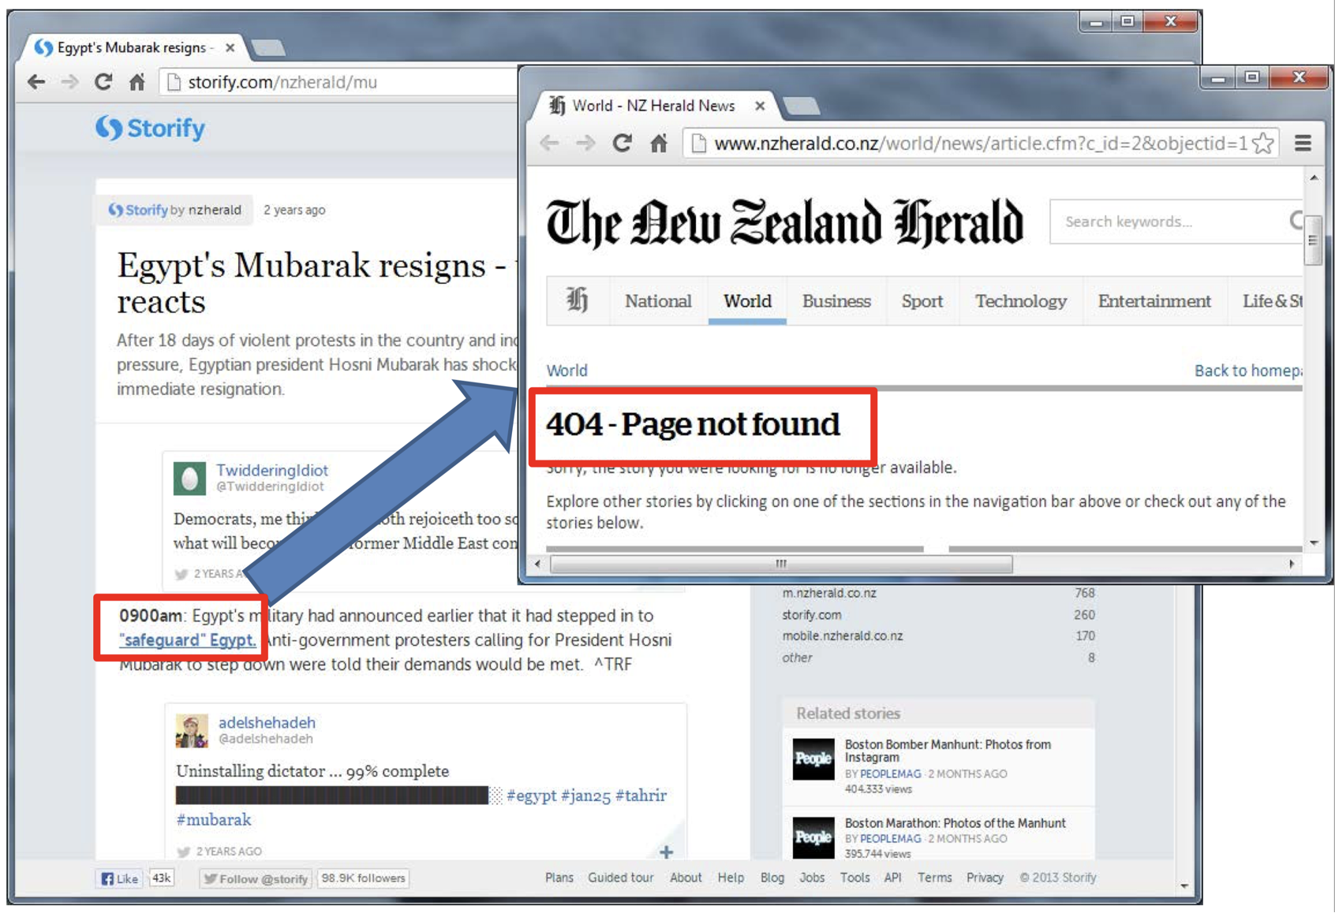
Existing Storytelling Services Are Bookmarking, Not Preserving!

Slide 9
Our goal is to
choose k items from N
where k << N

Slide 10
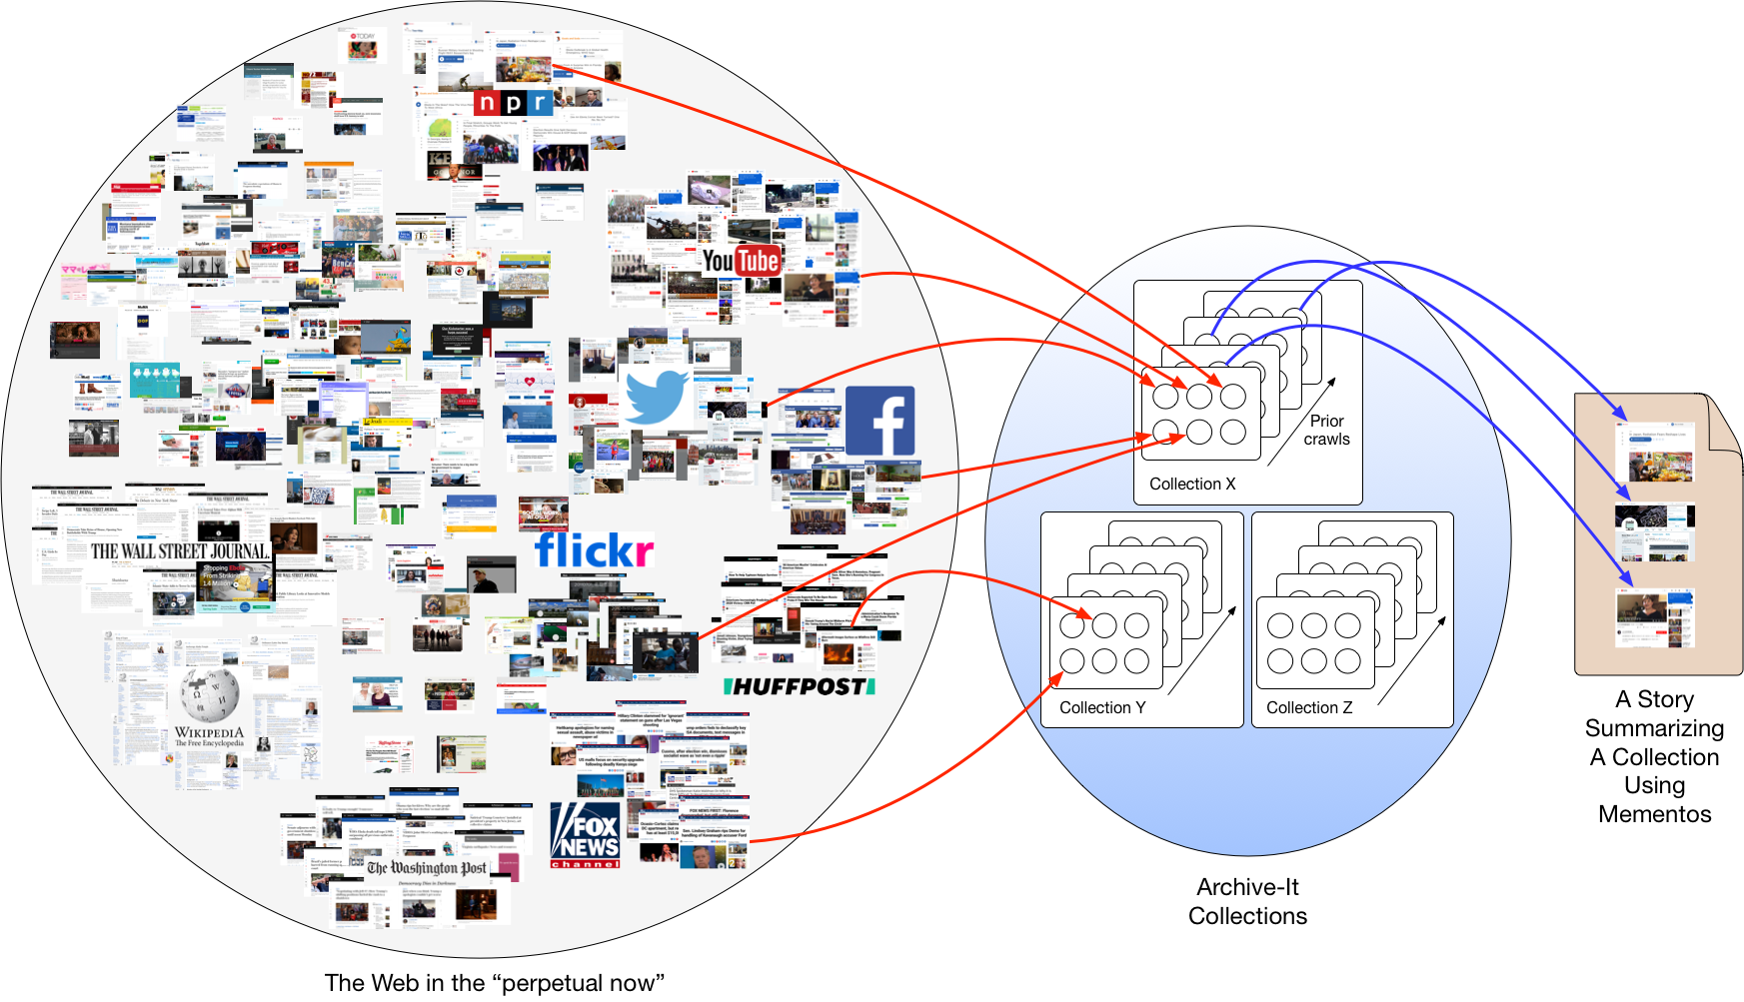
We Want to Sample k Mementos from N Pages of the Collection to Create a Summary Story
Web sites may group some content, but curators theme some of this content into collections which we can reduce to stories.

Slide 11
Manually Gathering Story Resources

Slide 12
How to start telling a story – manually
To tell a story, we must first explore our collection
What people, places, ideas are in the collection?
What story do we want to tell?
What events are the story centered on?
Do we want to address the 5Ws: who, what, when, where, how, why?
See: https://en.wikipedia.org/wiki/Storytelling

Slide 13
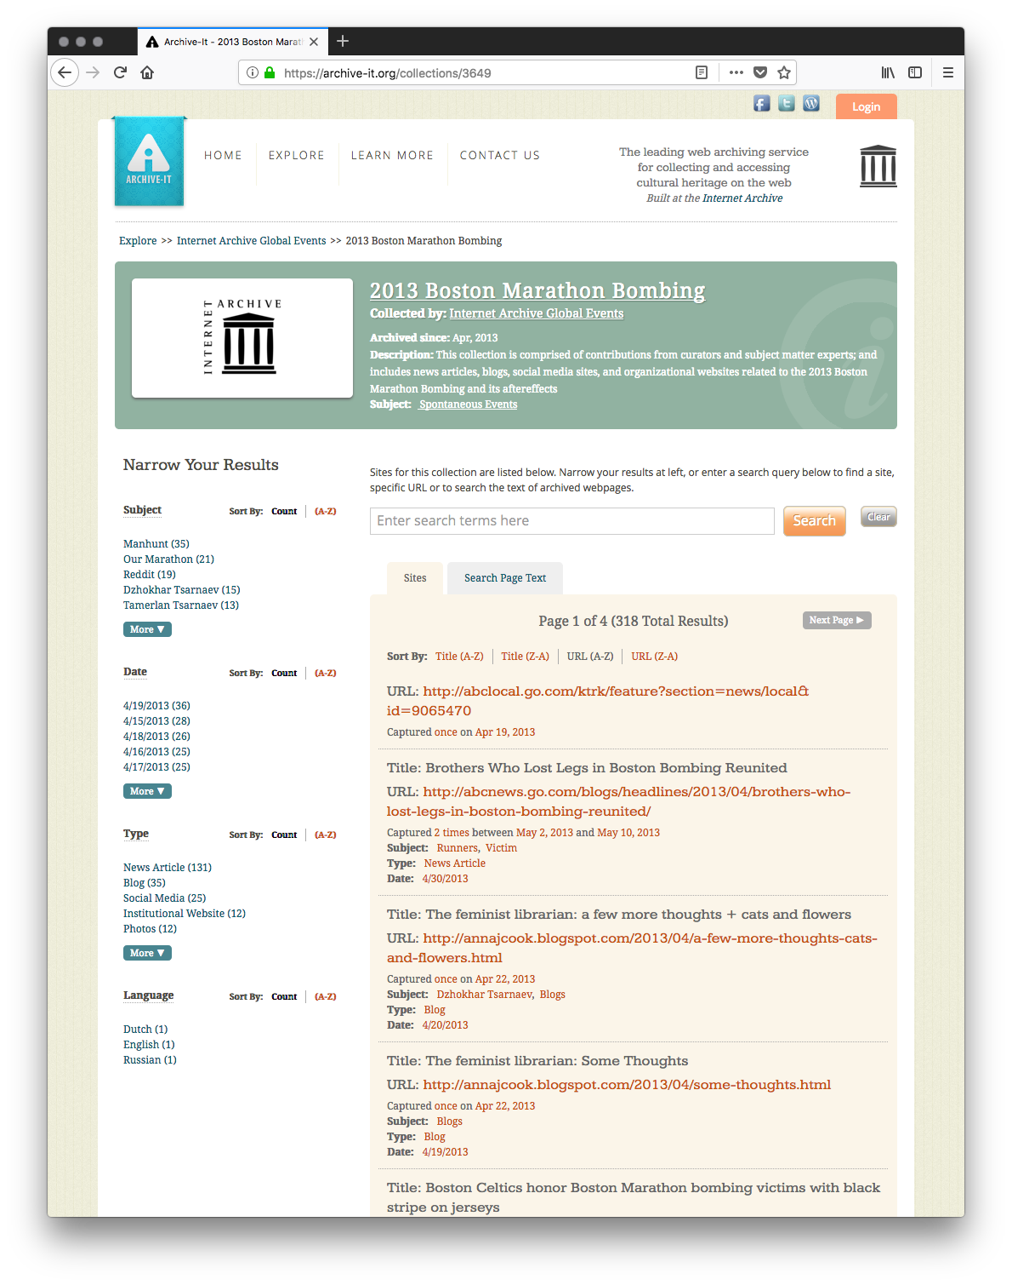
Web Archive Collections
Web archive collections consist of seeds and crawls of those seeds
The mementos from these crawls are versions of pages from the time of the crawl

Slide 14
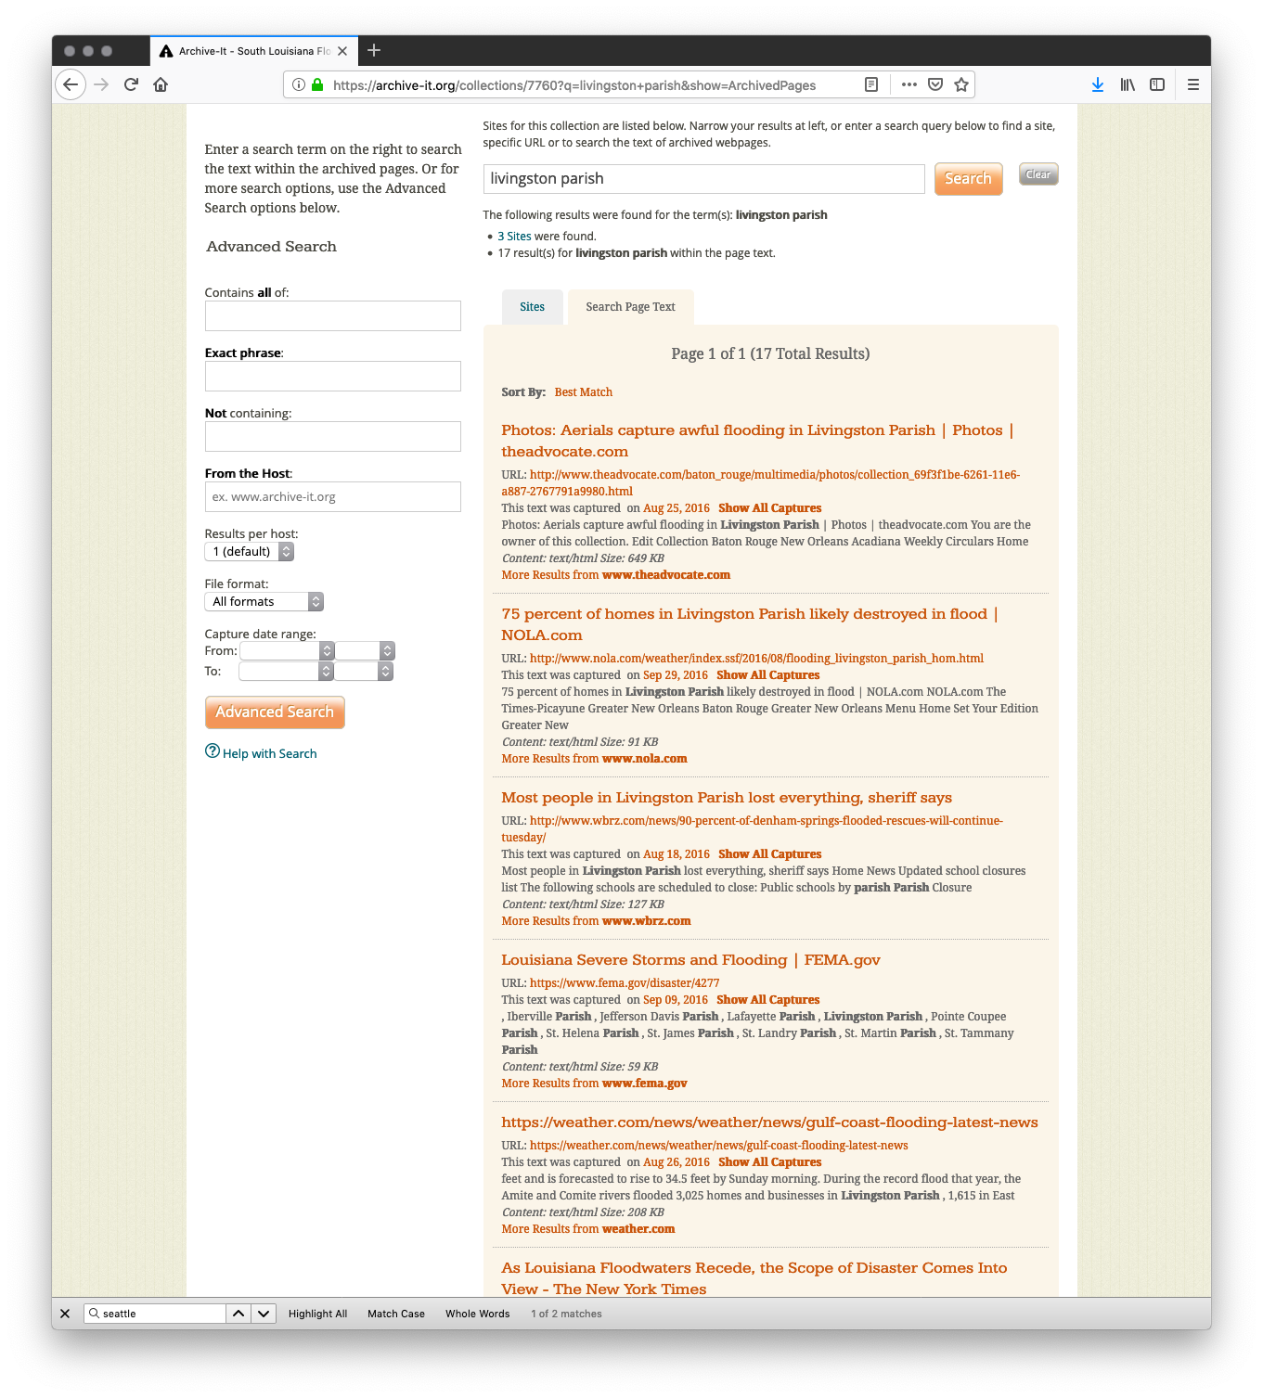
Gathering resources for your story – manually
Archive-It allows us to explore a collection via searching
Search for the people, places, etc. that reflect the story you wish to tell
From these searches, choose mementos and record their URLs
e.g., https://wayback.archive-it.org/7760/20160825195540/http://dailysignal.com/2016/08/18/im-from-louisiana-heres-the-flooding-story-the-media-should-cover/
There are 1000s of mementos to sift through
We need to choose around 28 mementos because that is the number used in popular stories
See: https://support.archive-it.org/hc/en-us/articles/208002196-Browse-and-search-on-archive-it-org

Slide 15
Automatically Gathering Story Resources

Slide 16
Storytelling with web archives: The Dark and Stormy Archives (DSA) Toolkit
Storytelling involves reduction and visualization of the large collection to some representative samples.
This process was developed by Yasmin AlNoamany.
We will use the Off-Topic Memento Toolkit (OTMT) to help us perform this reduction.
See: WebSci 2017, https://doi.org/10.1145/3091478.3091508
See: iPres 2018, https://doi.org/10.17605/OSF.IO/UBW87

Slide 17
Installing the Off-Topic Memento Toolkit (OTMT)
Create a new folder named otmt-working
Download the file docker-compose.yml from https://raw.githubusercontent.com/oduwsdl/off-topic-memento-toolkit/master/docker-compose.yml and save it to that folder
Open a terminal
Change into the directory you created in step 1
Type the following command:
docker-compose run otmt bash
Run the commands on the following slides from that prompt

Slide 18
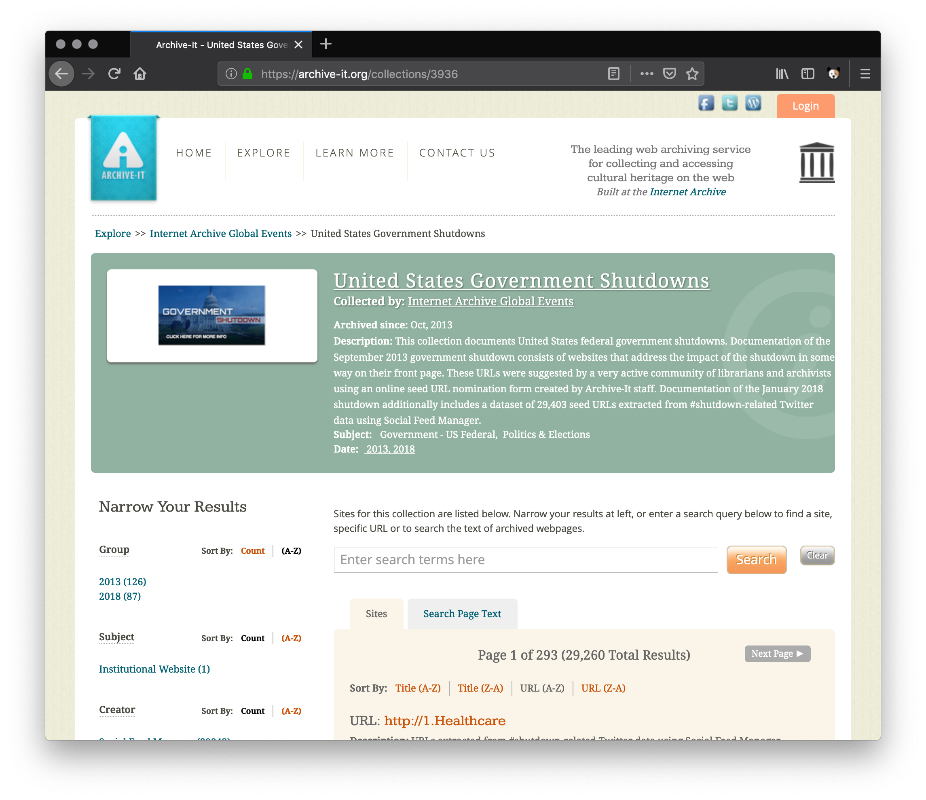
We Will Use Collection 3936 As Our Example For Summarization

Slide 19
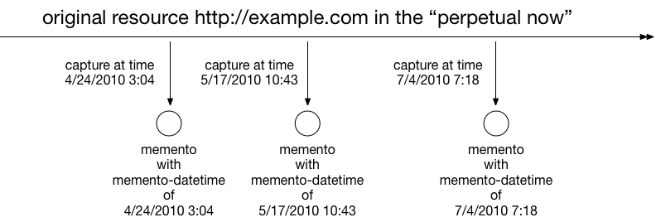
First We Remove Off-Topic Mementos, But Why?
Mementos are observations of seeds at different points in time
Things happen to web pages that make them go off-topic.
Red: off-topic, Green: on-topic
We want to identify and exclude (not remove) off-topic mementos because they do not make for good summaries
See: IJDL 2016, http://dx.doi.org/10.1007/s00799-016-0183-5

Slide 20
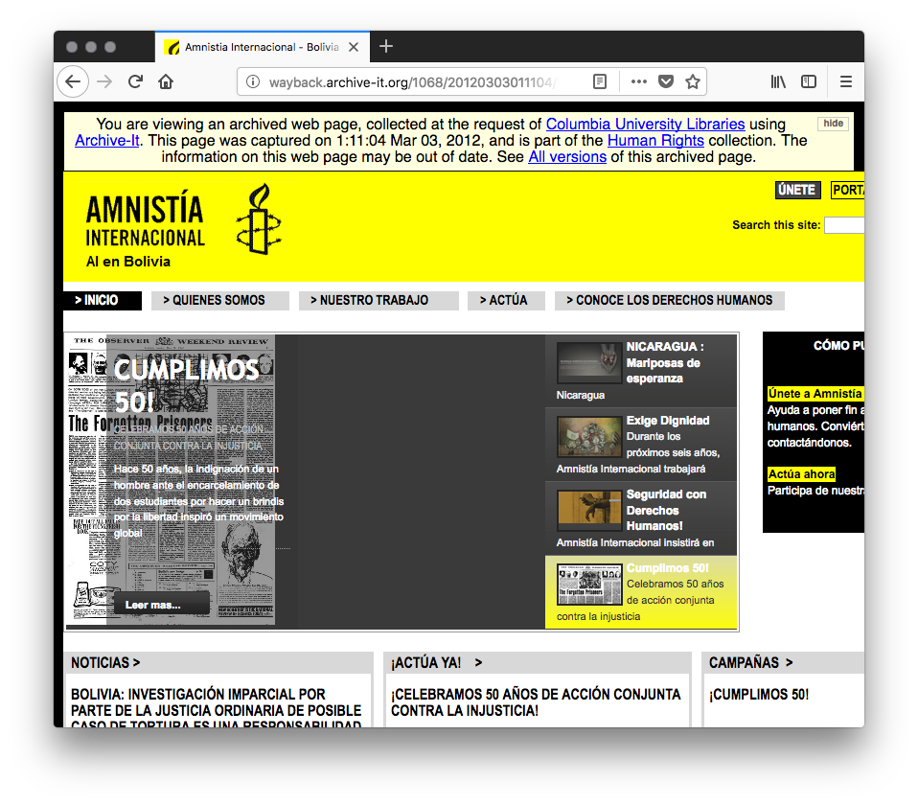
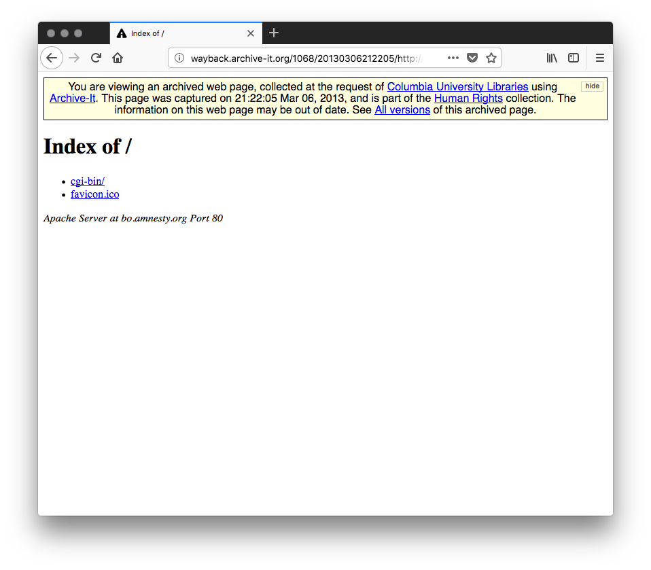
Mementos in a Collection Can Be Off-Topic: For Technical Reasons
http://wayback.archive-it.org/1068/20120303011104/http://bo.amnesty.org/
http://wayback.archive-it.org/1068/20130306212205/http://bo.amnesty.org/

Slide 21
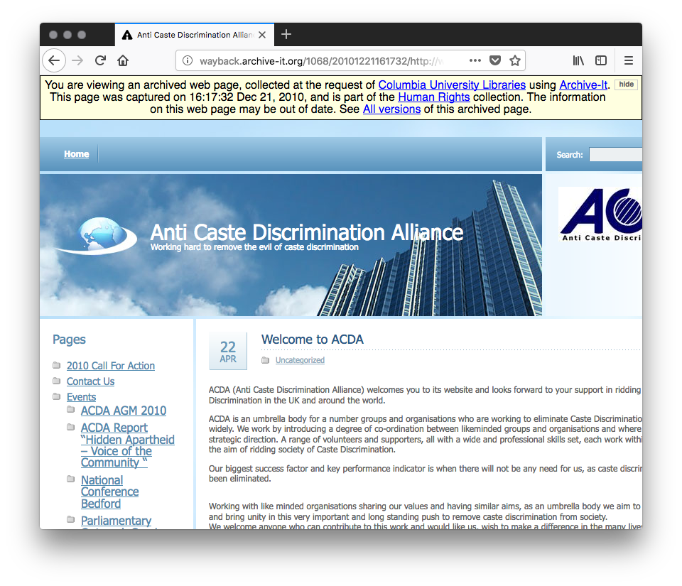
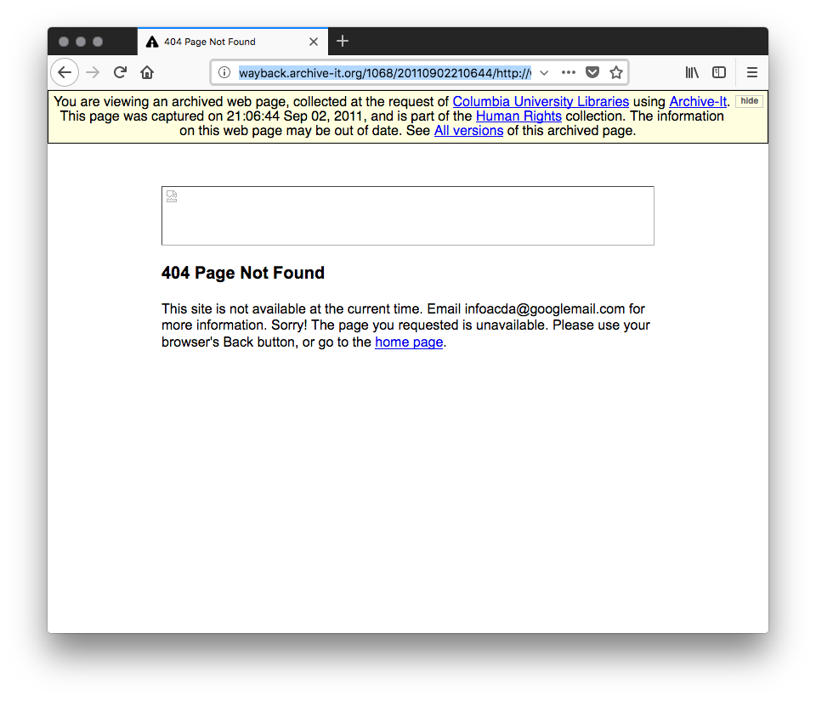
Mementos in a Collection Can Be Off-Topic: Page Gone
http://wayback.archive-it.org/1068/20101221161732/http://www.acdauk.org.uk/
http://wayback.archive-it.org/1068/20110902210644/http://www.acdauk.org.uk/

Slide 22
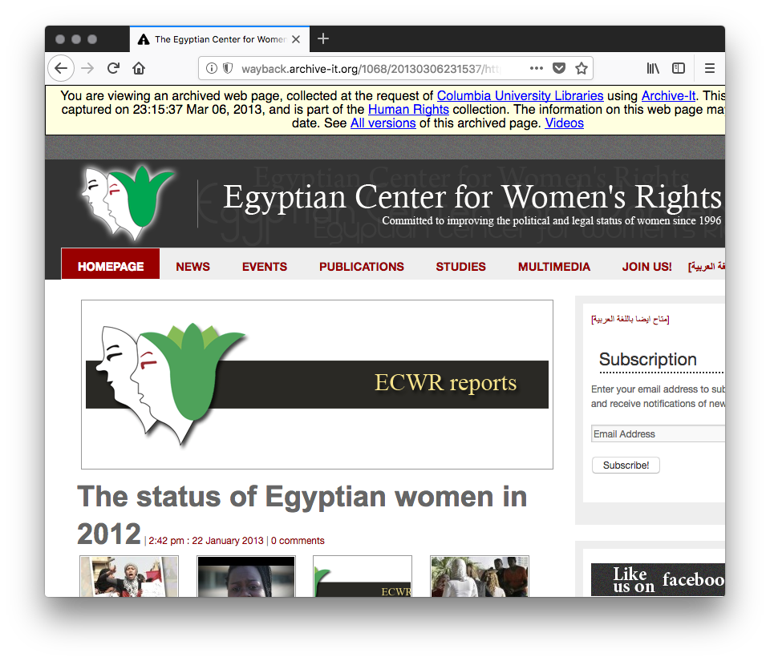
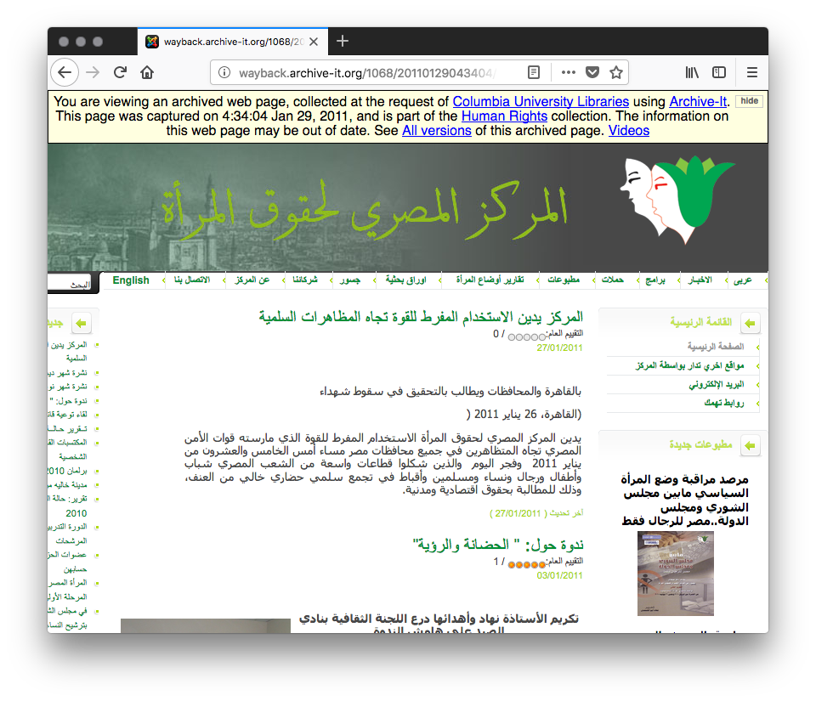
Mementos in a Collection Can Be Off-Topic: Content Drift – A Change in Languages
http://wayback.archive-it.org/1068/20110129043404/http://ecwronline.org/
http://wayback.archive-it.org/1068/20130306231537/http://ecwronline.org/

Slide 23
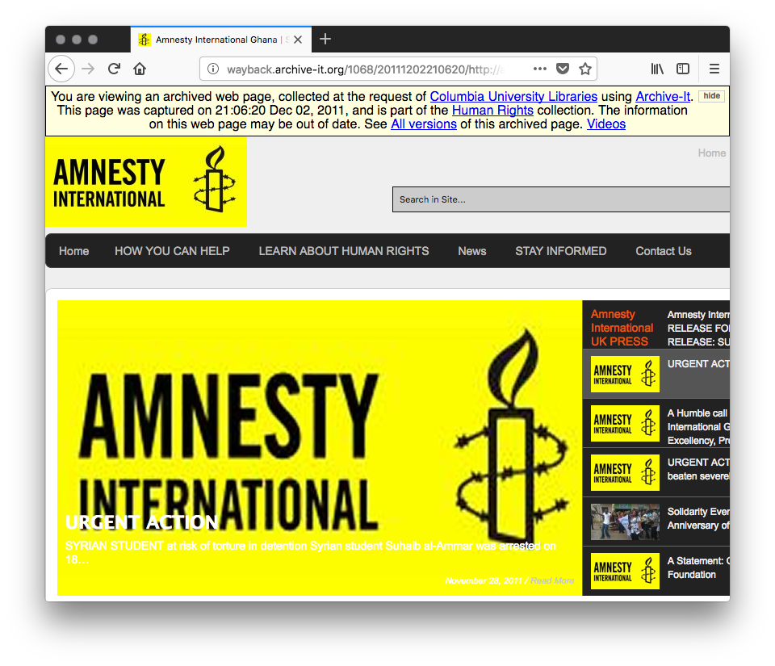
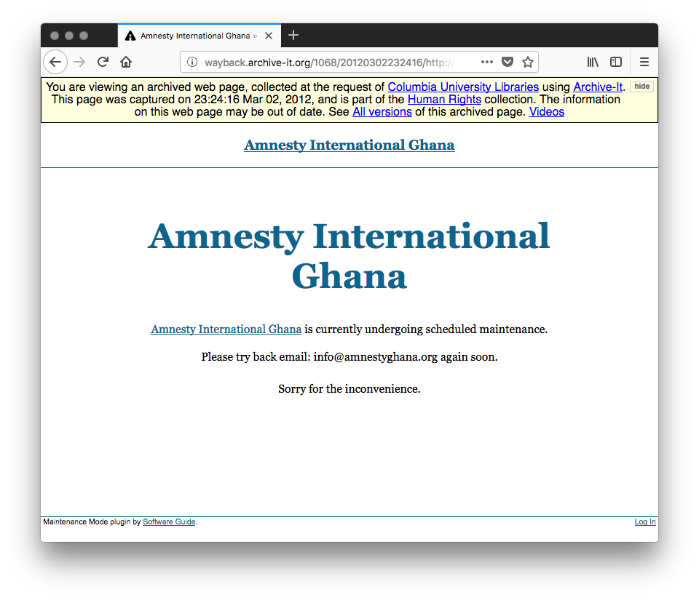
Mementos in a Collection Can Be Off-Topic: Server Maintenance
http://wayback.archive-it.org/1068/20111202210620/http://amnestyghana.org/
http://wayback.archive-it.org/1068/20120302232416/http://amnestyghana.org/

Slide 24
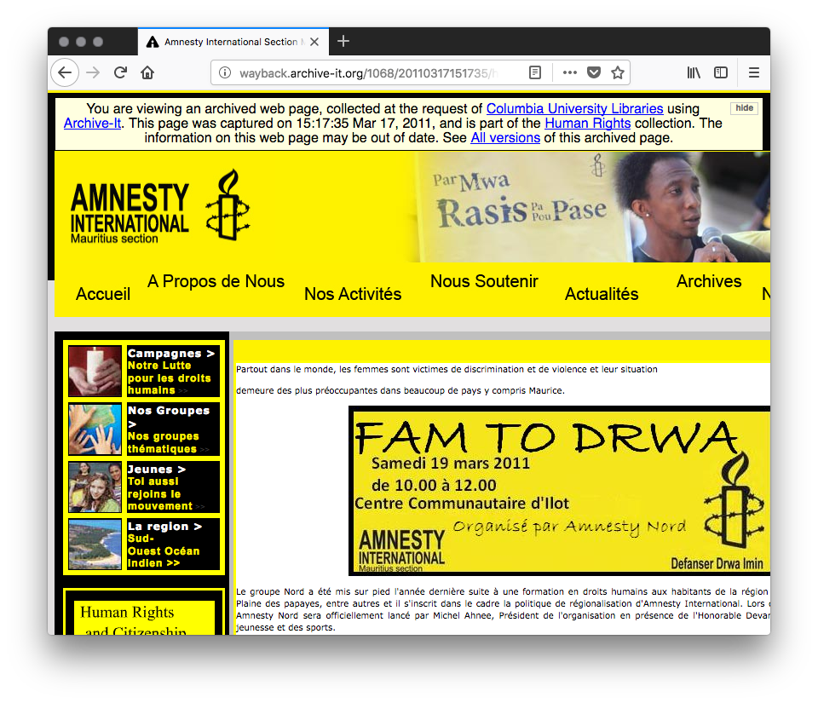
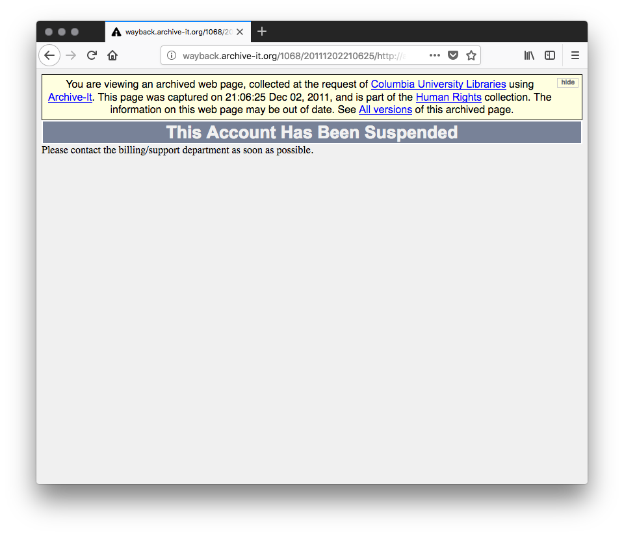
Mementos in a Collection Can Be Off-Topic: Account Suspension
http://wayback.archive-it.org/1068/20110317151735/http://amnestymauritius.org/french/news.php
http://wayback.archive-it.org/1068/20111202210625/http://amnestymauritius.org/cgi-sys/suspendedpage.cgi

Slide 25
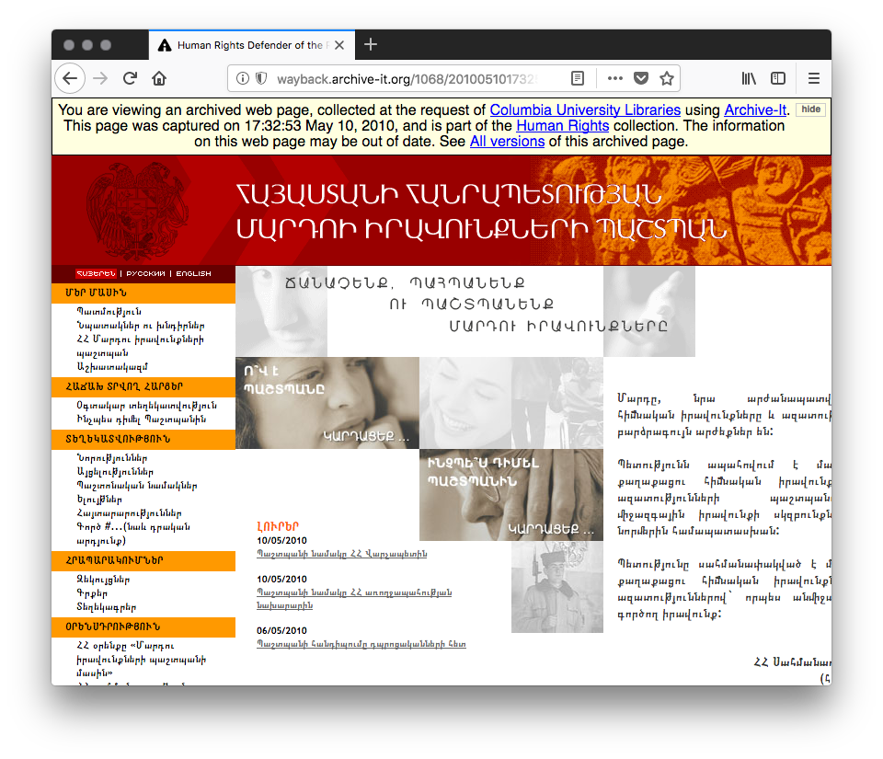
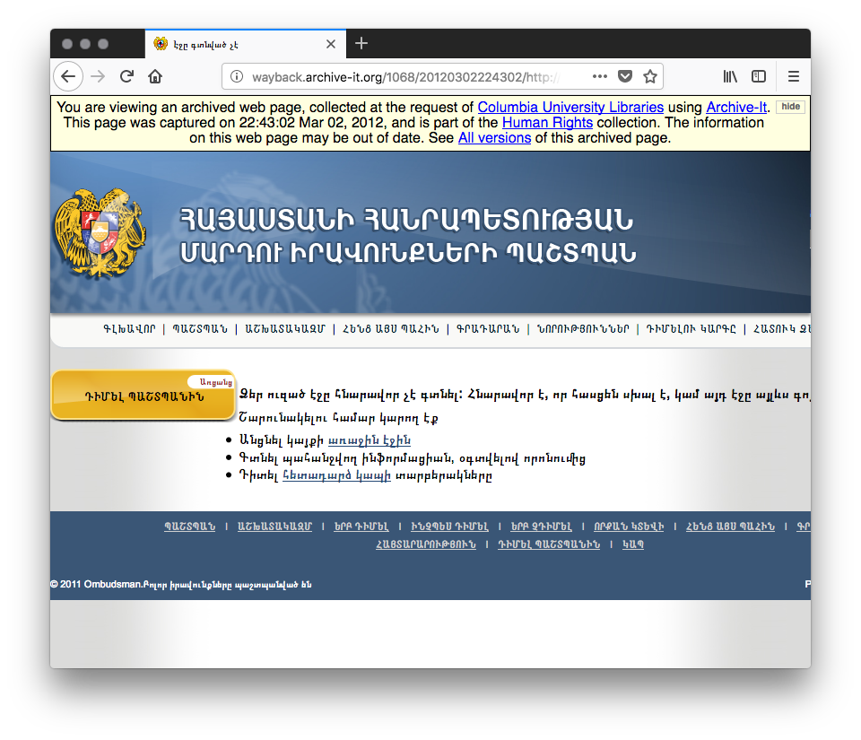
Mementos in a Collection Can Be Off-Topic: Site Redesign
http://wayback.archive-it.org/1068/20100510173253/http://ombuds.am/main
http://wayback.archive-it.org/1068/20120302224302/http://ombuds.am/main/

Slide 26
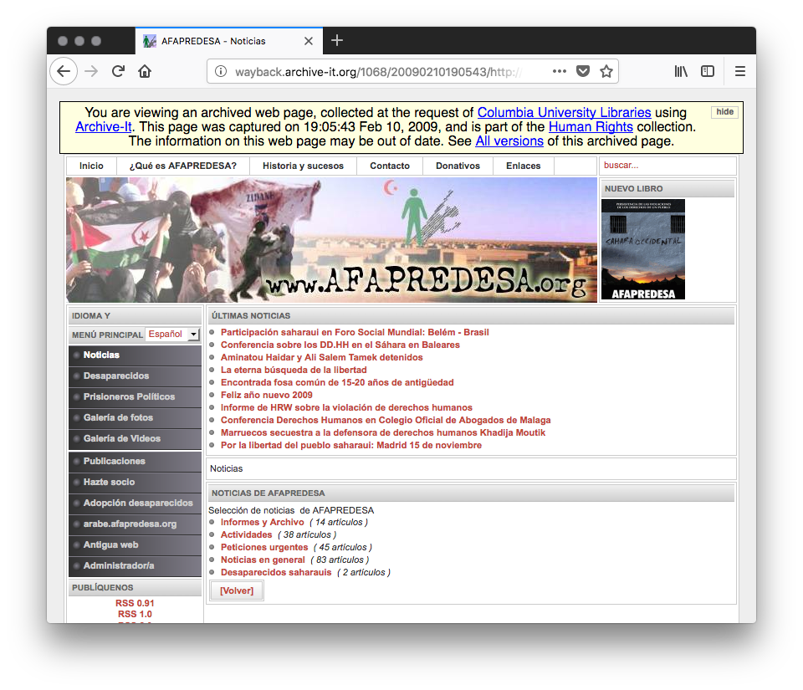
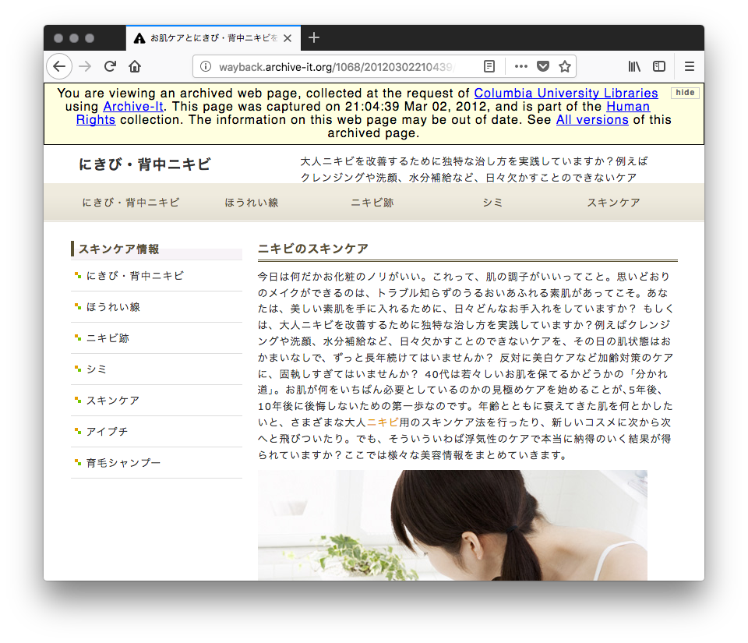
Mementos in a Collection Can Be Off-Topic: Change Site Ownership
http://wayback.archive-it.org/1068/20090210190543/http://www.afapredesa.org/index.php
http://wayback.archive-it.org/1068/20120302210439/http://www.afapredesa.org/

Slide 27
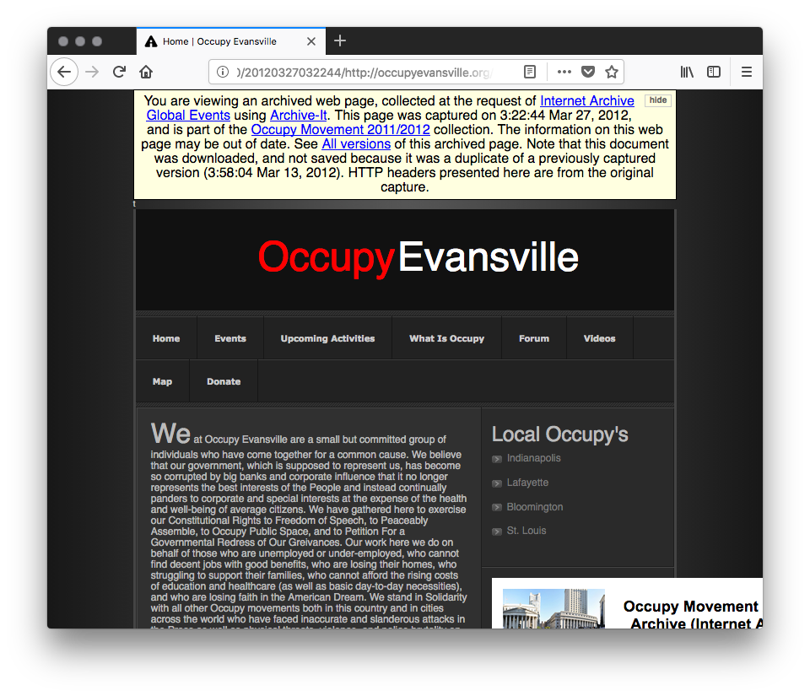
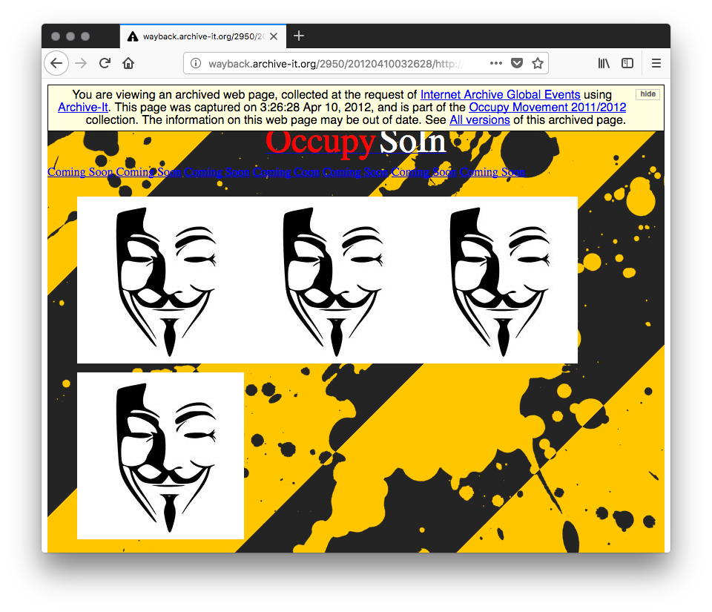
Mementos in a Collection Can Be Off-Topic: The Site Was Hacked
http://wayback.archive-it.org/2950/20120327032244/http://occupyevansville.org/
http://wayback.archive-it.org/2950/20120410032628/http://occupyevansville.org/

Slide 28
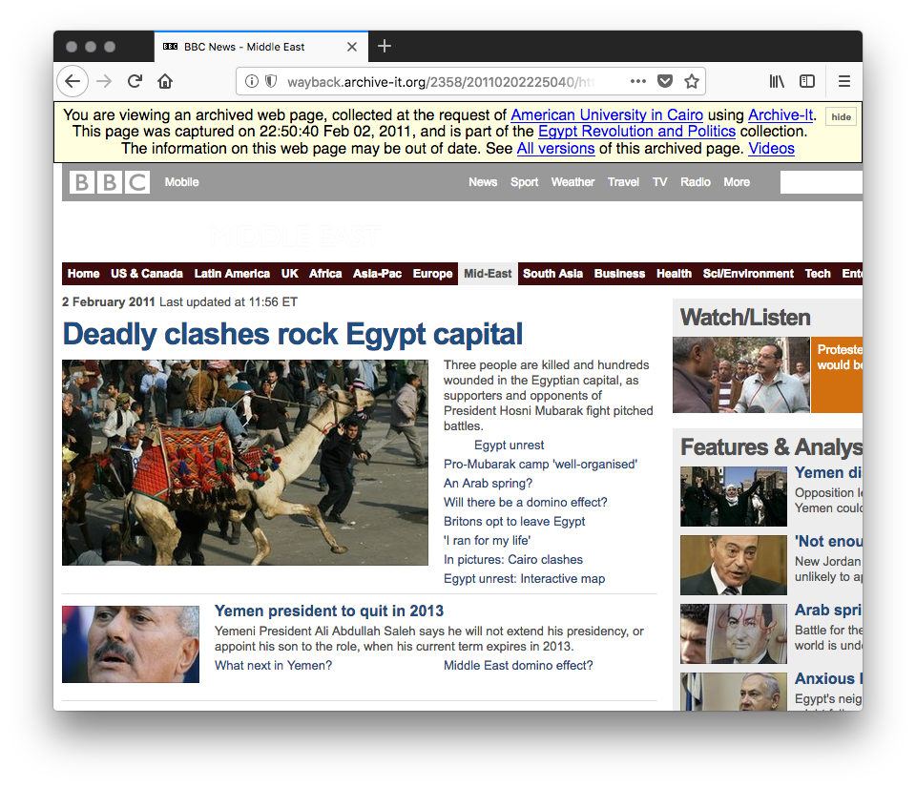
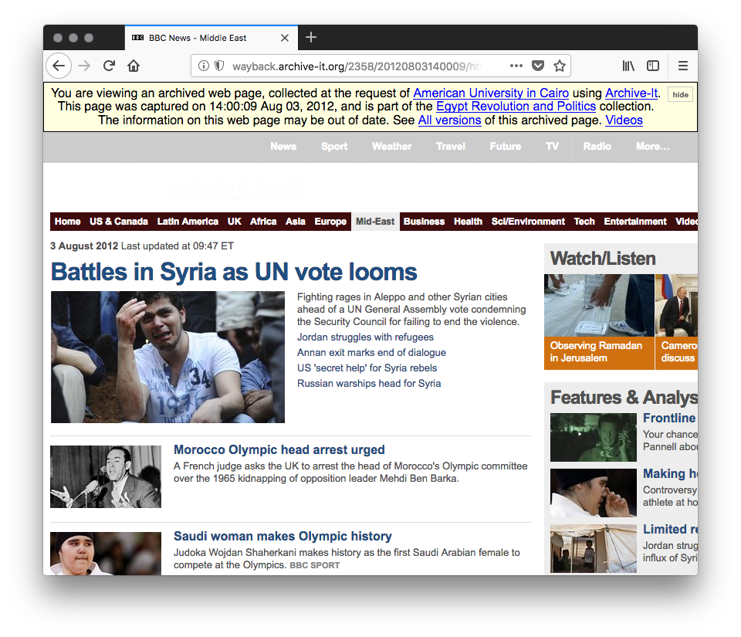
Mementos in a Collection Can Be Off-Topic: The Site Moves On From The Topic
http://wayback.archive-it.org/2358/20110202225040/http://www.bbc.co.uk/news/world/middle_east/
http://wayback.archive-it.org/2358/20120803140009/http://www.bbc.co.uk/news/world/middle_east/

Slide 29
Removing Off-Topic Pages
Open a terminal
Type the following:
detect_off_topic -i archiveit=3936 -o 3936-otmt.json --ontopic-file 3936-ontopic.txt
3936-otmt.json is data about collection 3936, replace 3936 with the identifier for your collection (e.g., 2358)
3936-ontopic.txt contains the list of mementos that are on-topic for this collection
When the prompt returns, the command has finished executing

Slide 30
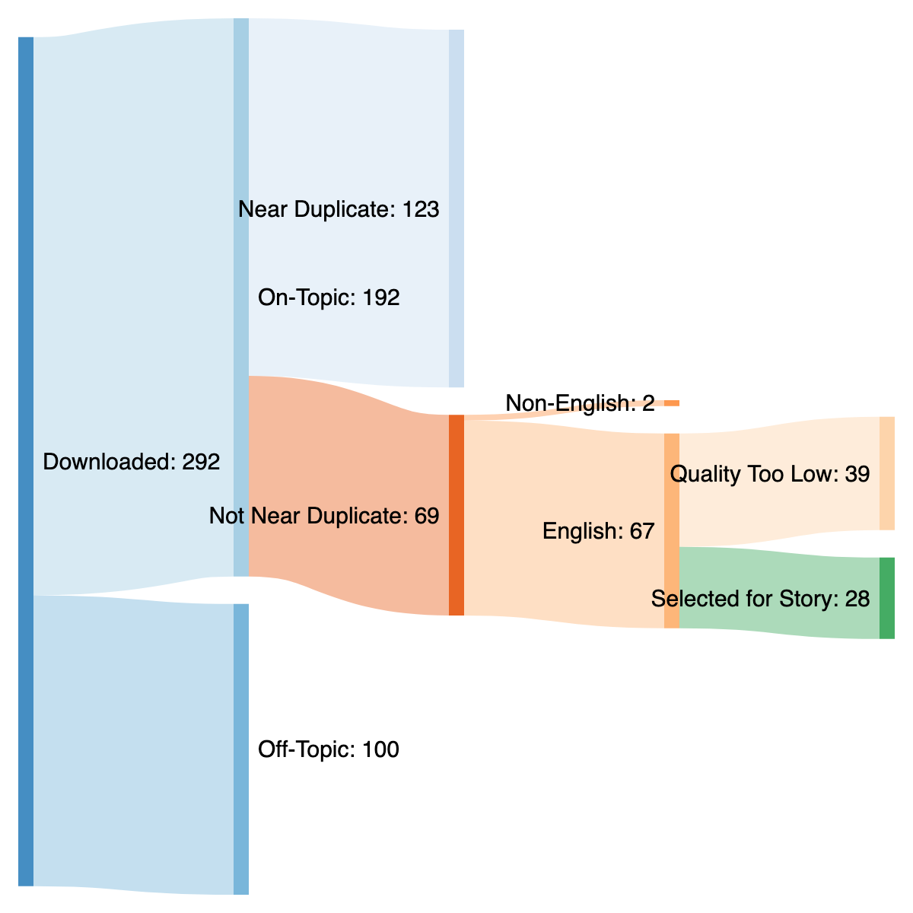
Excluding Off-Topic Pages
100 Off-Topic Pages
Excluded From Consideration

Slide 31
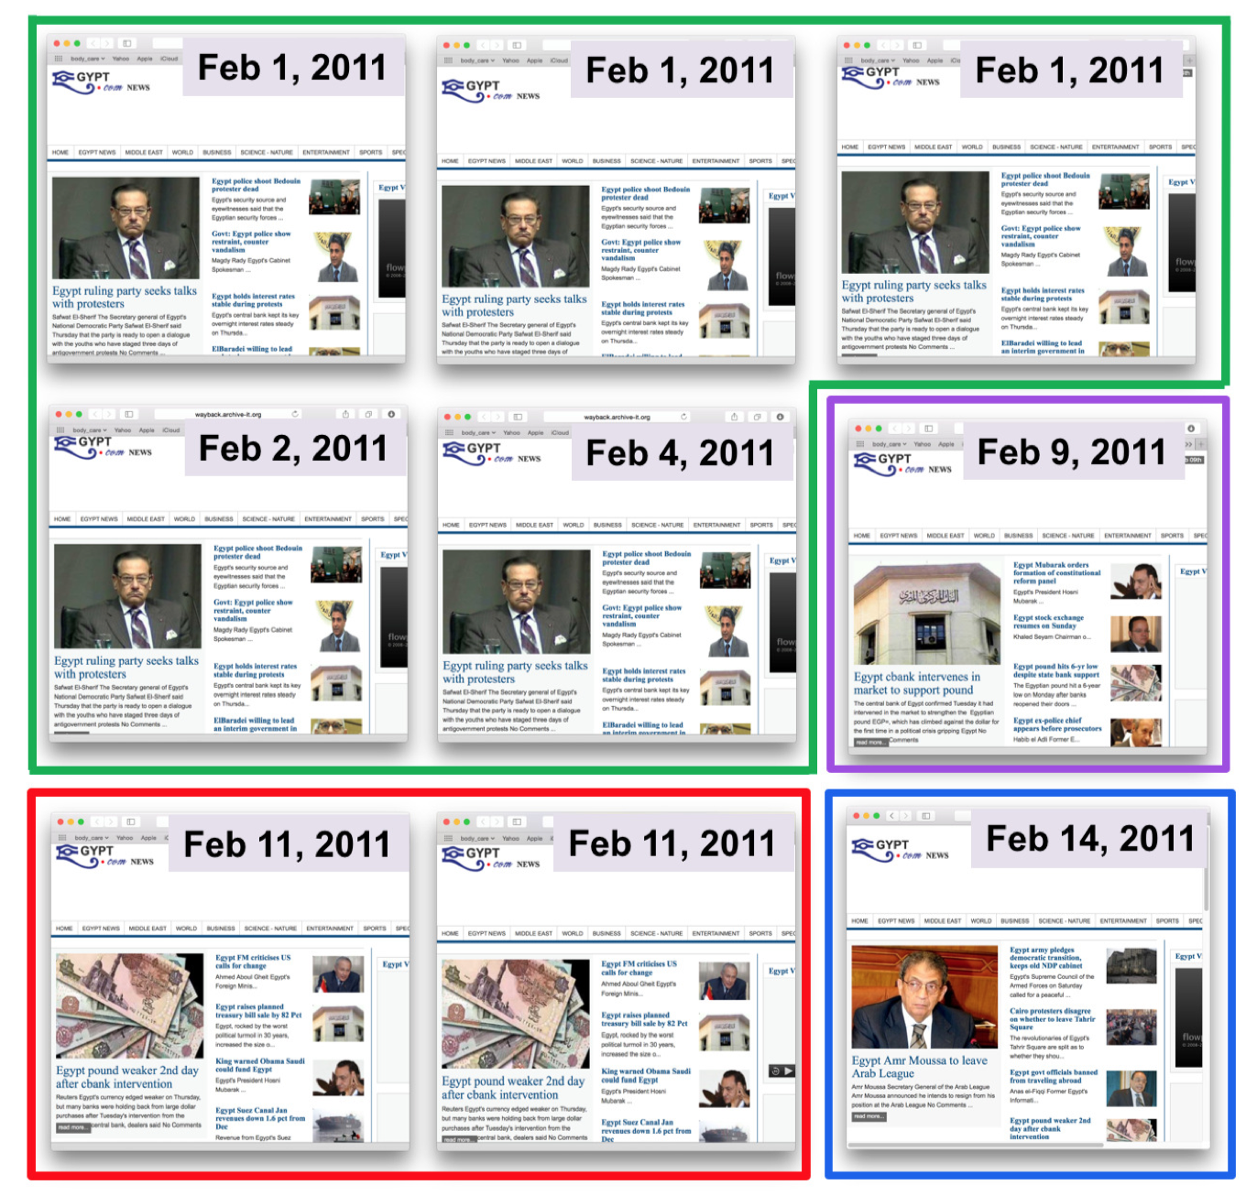
Many Duplicates Exist in a Web Archive Collection
Remember: A memento is an observation at a particular point in time
Sometimes the web page did not change
These duplicates are extras that we do not need in our story
Thumbnails of duplicate mementos, grouped by color.
Mementos outlined in red are the same, green are the same, etc.

Slide 32
Excluding Duplicate Mementos
Type the following:
exclude_duplicates -i 3936-otmt.json -c 3936-ontopic.txt –o 3936-nonduplicates.txt
3936-otmt.json is data about collection 3936 generated in the previous section
3936-ontopic.txt contains the list of mementos that are on-topic from the previous step
3936-nonduplicates.txt contains the list of mementos that are not duplicates, it will be used in the next step

Slide 33
Excluding Duplicate Mementos
123 Near-Duplicates
Excluded From Consideration

Slide 34
Not all mementos are the same language
We want to tell stories with a single language

Slide 35
Excluding mementos by language
Type the following:
select_by_language -i 3936-otmt.json -c 3936-nonduplicates.txt --lang en –o 3936-lang.en.txt
3936-otmt.json is data about collection 3936 generated in the previous section
3936-nonduplicates.txt contains the list of mementos that are not duplicates from the previous step
3936-lang.en.txt contains the list of mementos that are not duplicates and are English language, it will be used in the next step

Slide 36
Excluding Mementos By Language
2 Non-English Mementos
Excluded From Consideration

Slide 37
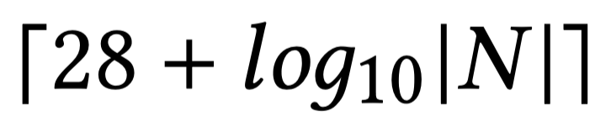
Our collections spread across time
To ensure we account for the spread across time, we slice the collection dynamically and distribute the mementos equally on the slices.
For N mementos:
If |N| <= 28, then the number of slices is |N|
If |N| > 28, then the number of slices is:
This way the size of the story grows slowly as needed for large collections

Slide 38
Slice the mementos by datetime
Type the following:
slice_by_datetime -i 3936-otmt.json -c 3936-lang.en.txt –o 3936-sliced.tsv
3936-otmt.json is data about collection 3936 generated in the previous section
3936-lang.en.txt contains the list of on-topic mementos that are not duplicates and are English language from the previous step
3936-sliced.tsv contains a tab-delimited list of memento URLs and their slice numbers, it will be used in the next step

Slide 39
Finding novel mementos by clustering
To ensure we find novel mementos, we reuse the Simhash scores from the deduplication step
Each cluster is built from the distance between these Simhash scores using the DBSCAN algorithm

Slide 40
Cluster the mementos in each slice
Type the following:
cluster_by_simhash -i 3936-otmt.json -s 3936-sliced.tsv –o 3936-clustered.tsv
3936-otmt.json is data about collection 3936 generated in the previous section
3936-sliced.tsv contains a tab-delimited list of memento URLs and their slice numbers from the previous step
3936-clustered.tsv contains a tab-delimited list of memento URLs with their slices and clusters, it will be used in the next step

Slide 41
High Quality Pages
We favor pages with the following features:
News over social media, because social media posts produce poorer cards
Longer URLs with deeper paths, because they contain more unique information and thus produce better cards
They have low memento damage

Slide 42
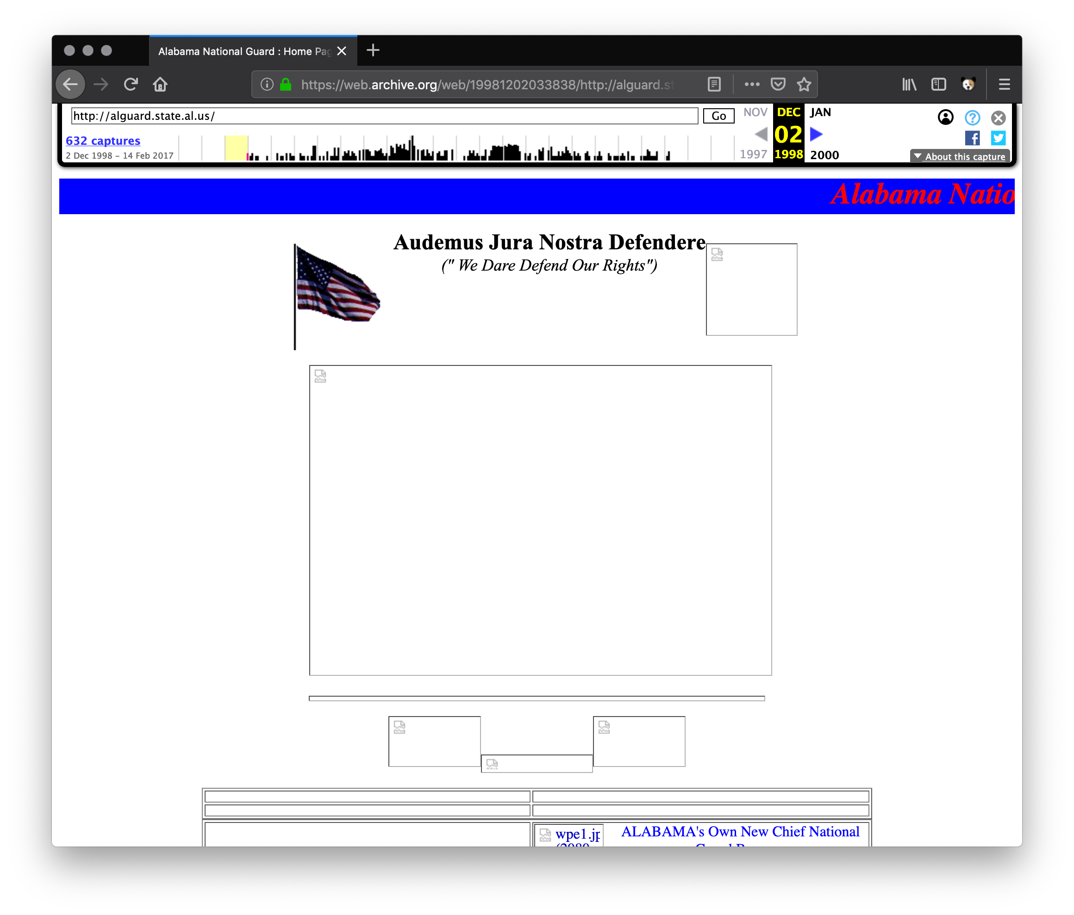
Memento Damage
Sometimes, when crawling, a web archive does not acquire all of the images, stylesheets, or JavaScript to render a page
This lack of resources is called damage
The memento damage tool was installed at the beginning
Note that calculating memento damage takes a long time, so this next step will take a while
See: IJDL 2015, https://doi.org/10.1007/s00799-015-0150-6
See: https://ws-dl.blogspot.com/2017/11/2017-11-22-deploying-memento-damage.html

Slide 43
Selecting High-Quality Pages
Type the following:
select_high_quality -i 3936-clustered.tsv --damage-uri http://localhost:8888 –o 3936-story-mementos.txt
3936-clustered.tsv contains the list of mementos, their slices, and their clusters from the previous step
3936-story_mementos.txt contains the list of memento URLs for our story
With this list, we can now visualize our story

Slide 44
Selecting High-Quality Pages
28 High Quality Mementos
Have Been Selected

Slide 45
Shutting Down the OTMT
In the terminal, type:
exit
Shut down the Docker containers:
docker-compose stop
Remove the Docker containers:
docker-compose rm -f

Slide 46
Visualizing The Story

Slide 47
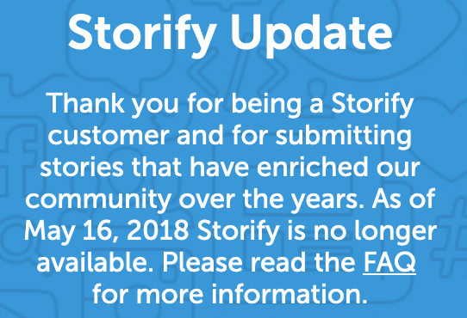
Storify shut down on May 16, 2018
Originally we visualized stories from web archive collections by using Storify.
Because Storify shut down in 2018, we need to visualize the stories with alternative tools.
https://storify.com/

Slide 48
Manually Visualizing The Story

Slide 49
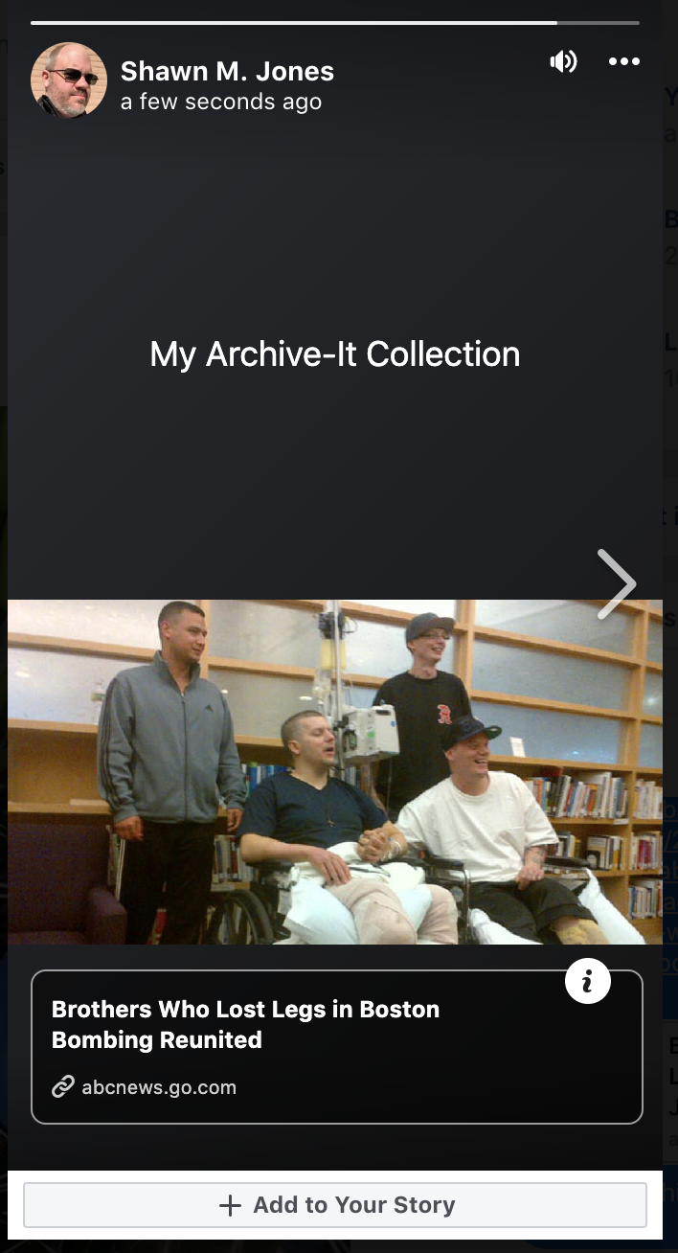
Stories on Facebook
Facebook offers “Stories”, but these are Snapchat-style videos, photos, or text that only last for 24 hours and then disappear.
Their short life and restricted audience make them difficult to share.
They are the opposite of an archival image.
We recommend an alternative.
See: https://www.facebook.com/help/126560554619115

Slide 50
Creating a Web Archive Summary Story on Facebook
Create a Facebook post with the title of your story as the text
Create a comment
Take the first URL from your story resources and place it in the comment
Wait for the card to appear
Repeat for each additional URL, in order

Slide 51
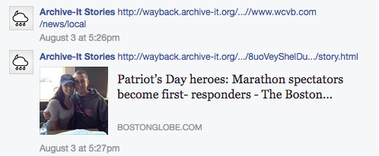
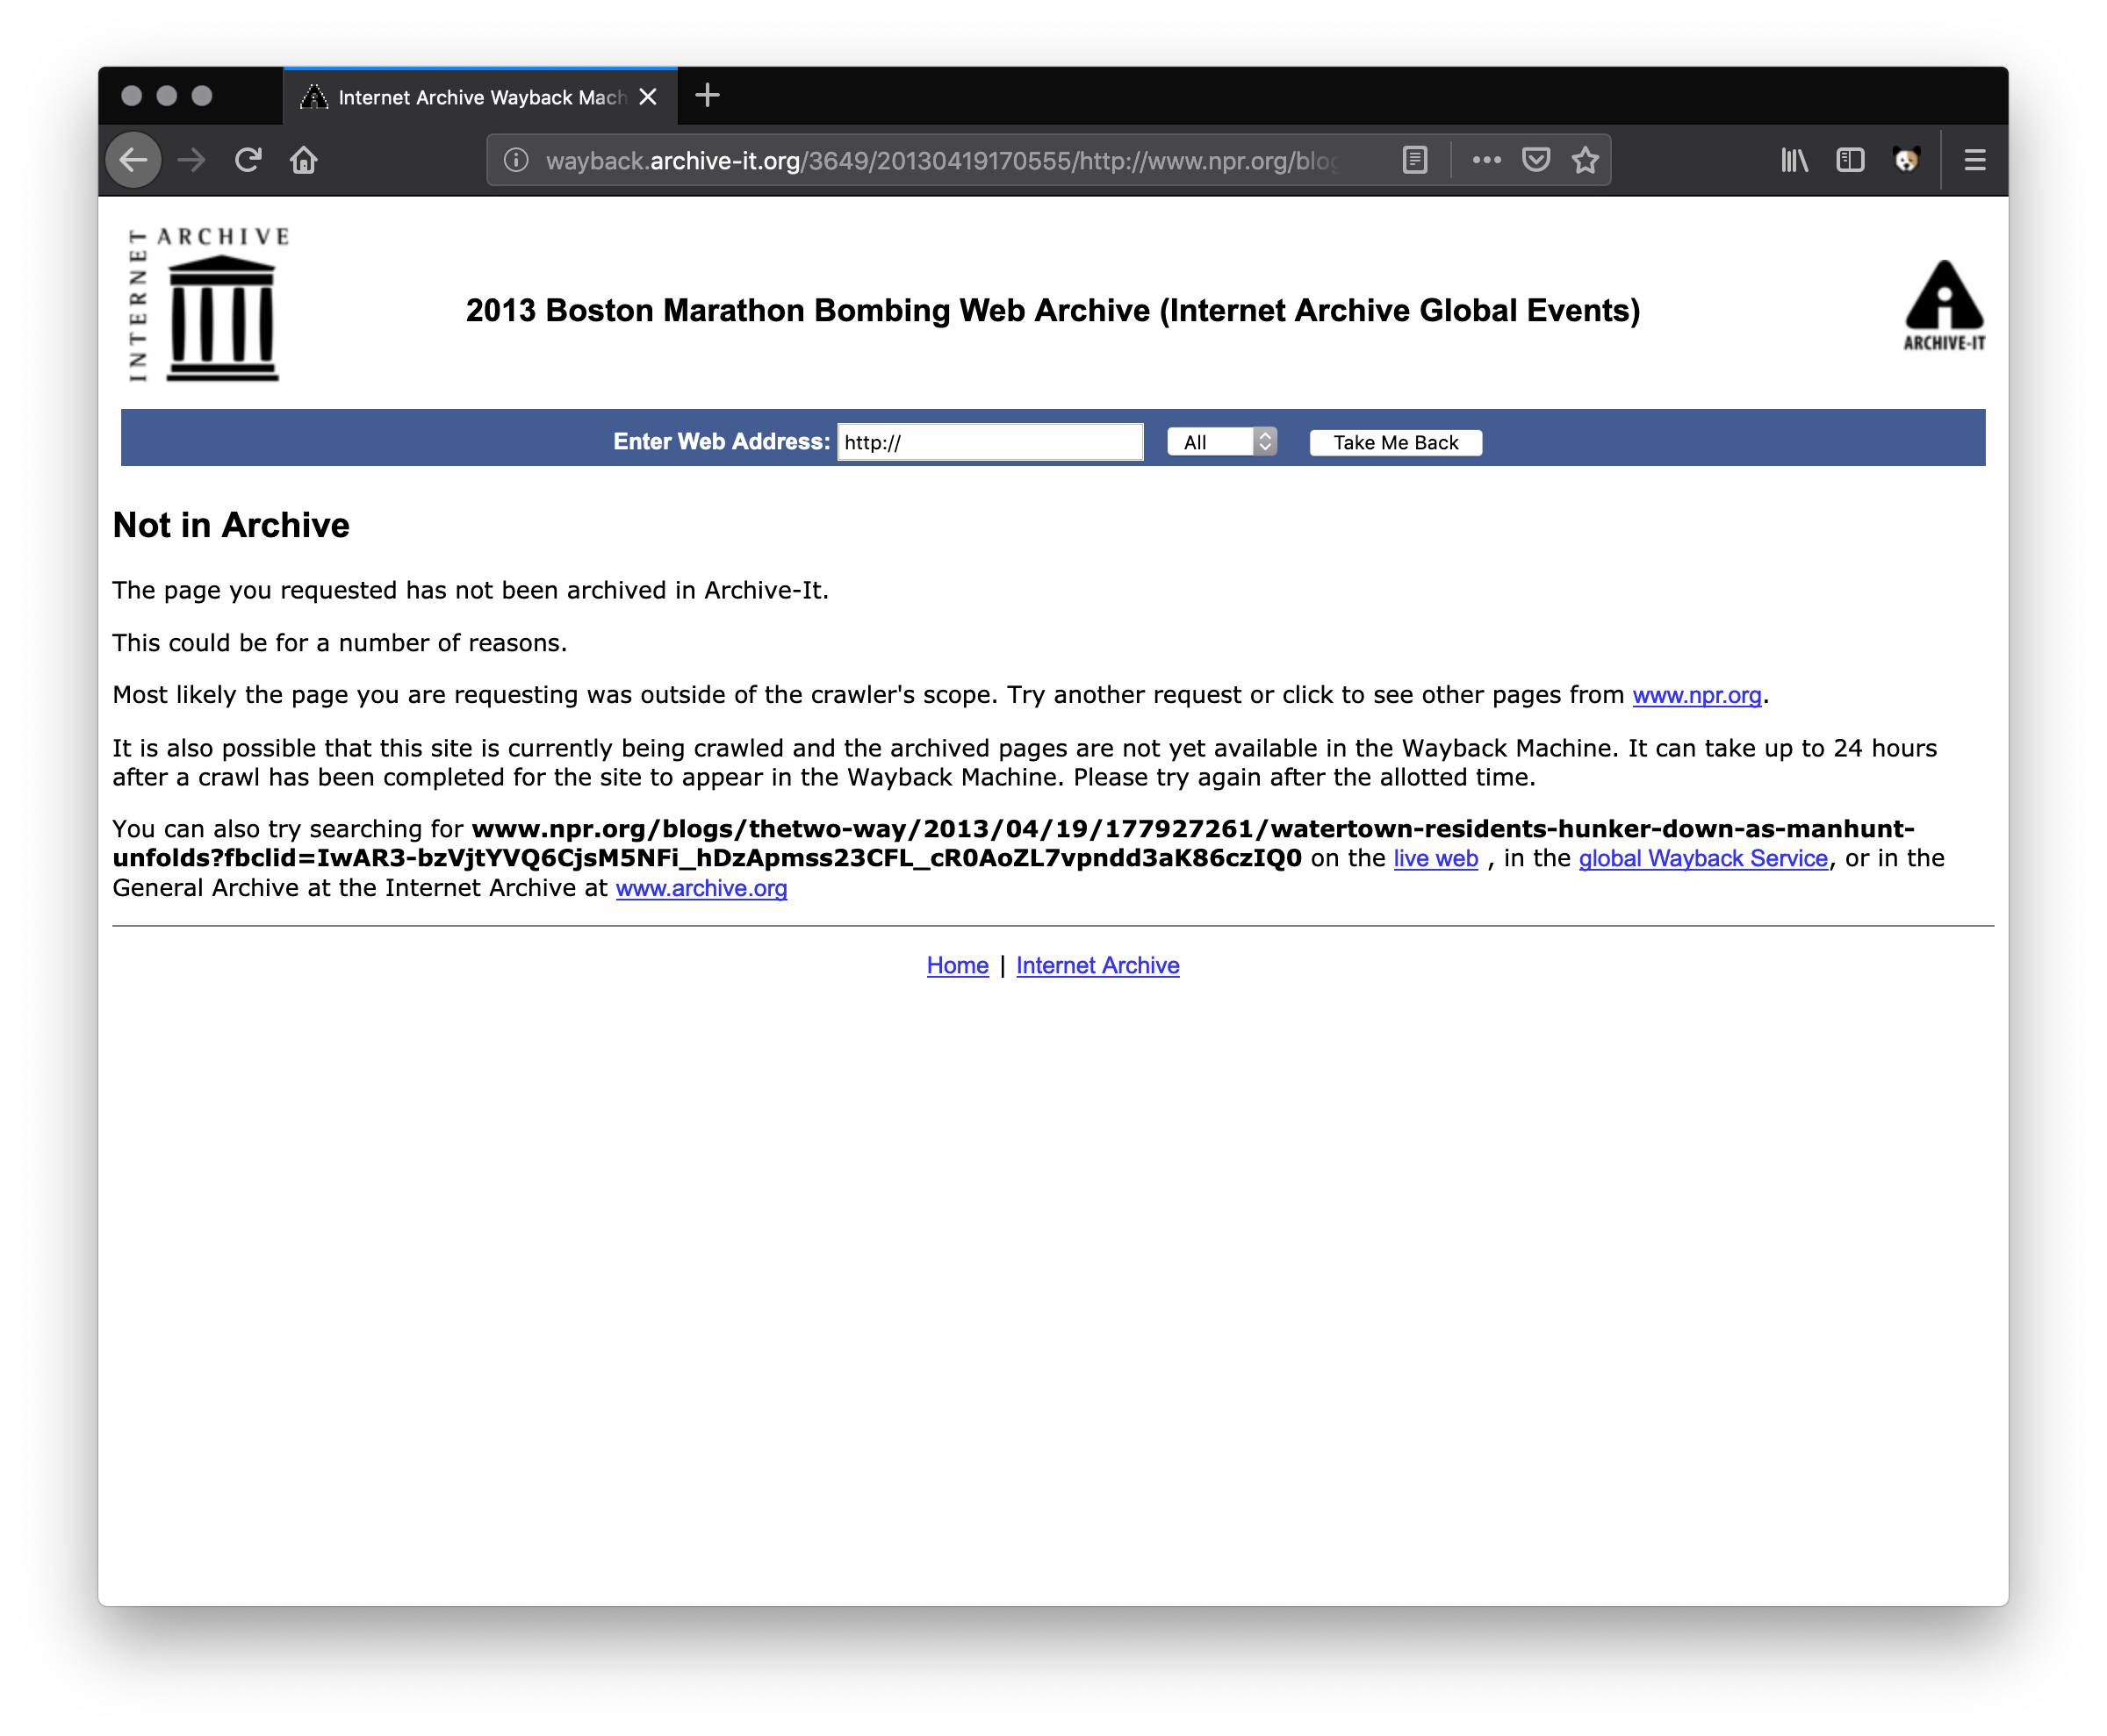
Problems with Summary Stories on Facebook
Facebook does not always generate a card for a link.
You can fix this by editing the comment and inserting your own text and image.
If a logged-in Facebook user clicks on a card, they will not get to the memento.
Facebook adds extra “stuff” to the end of a URL for logged-in users, and web archives may consider this ”stuff” to be part of the URL, so your viewer will get a 404.

Slide 52
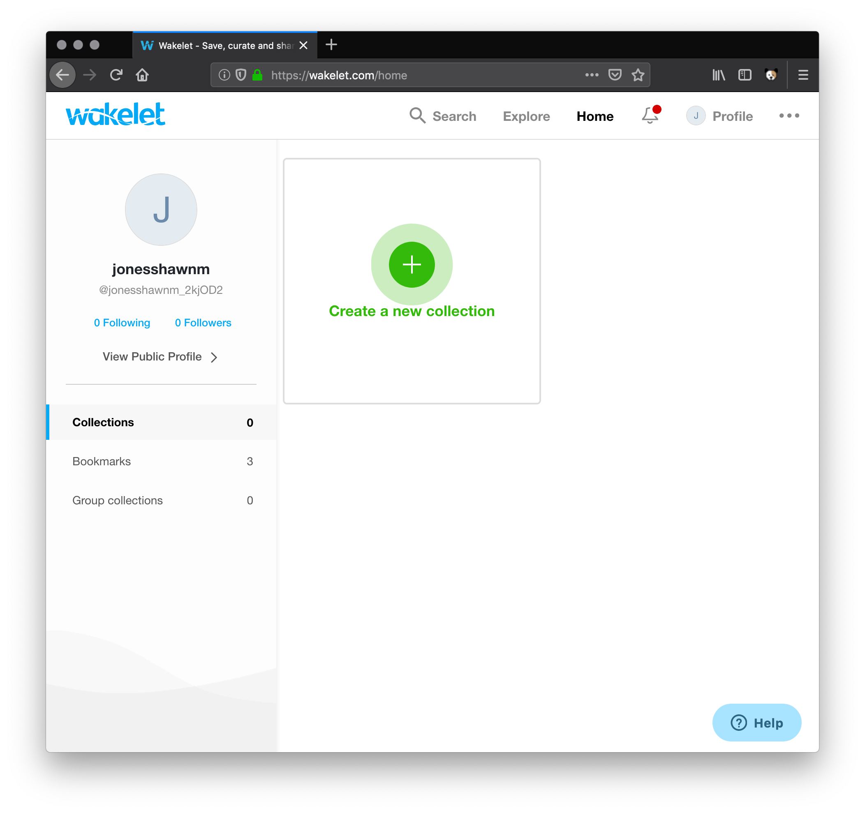
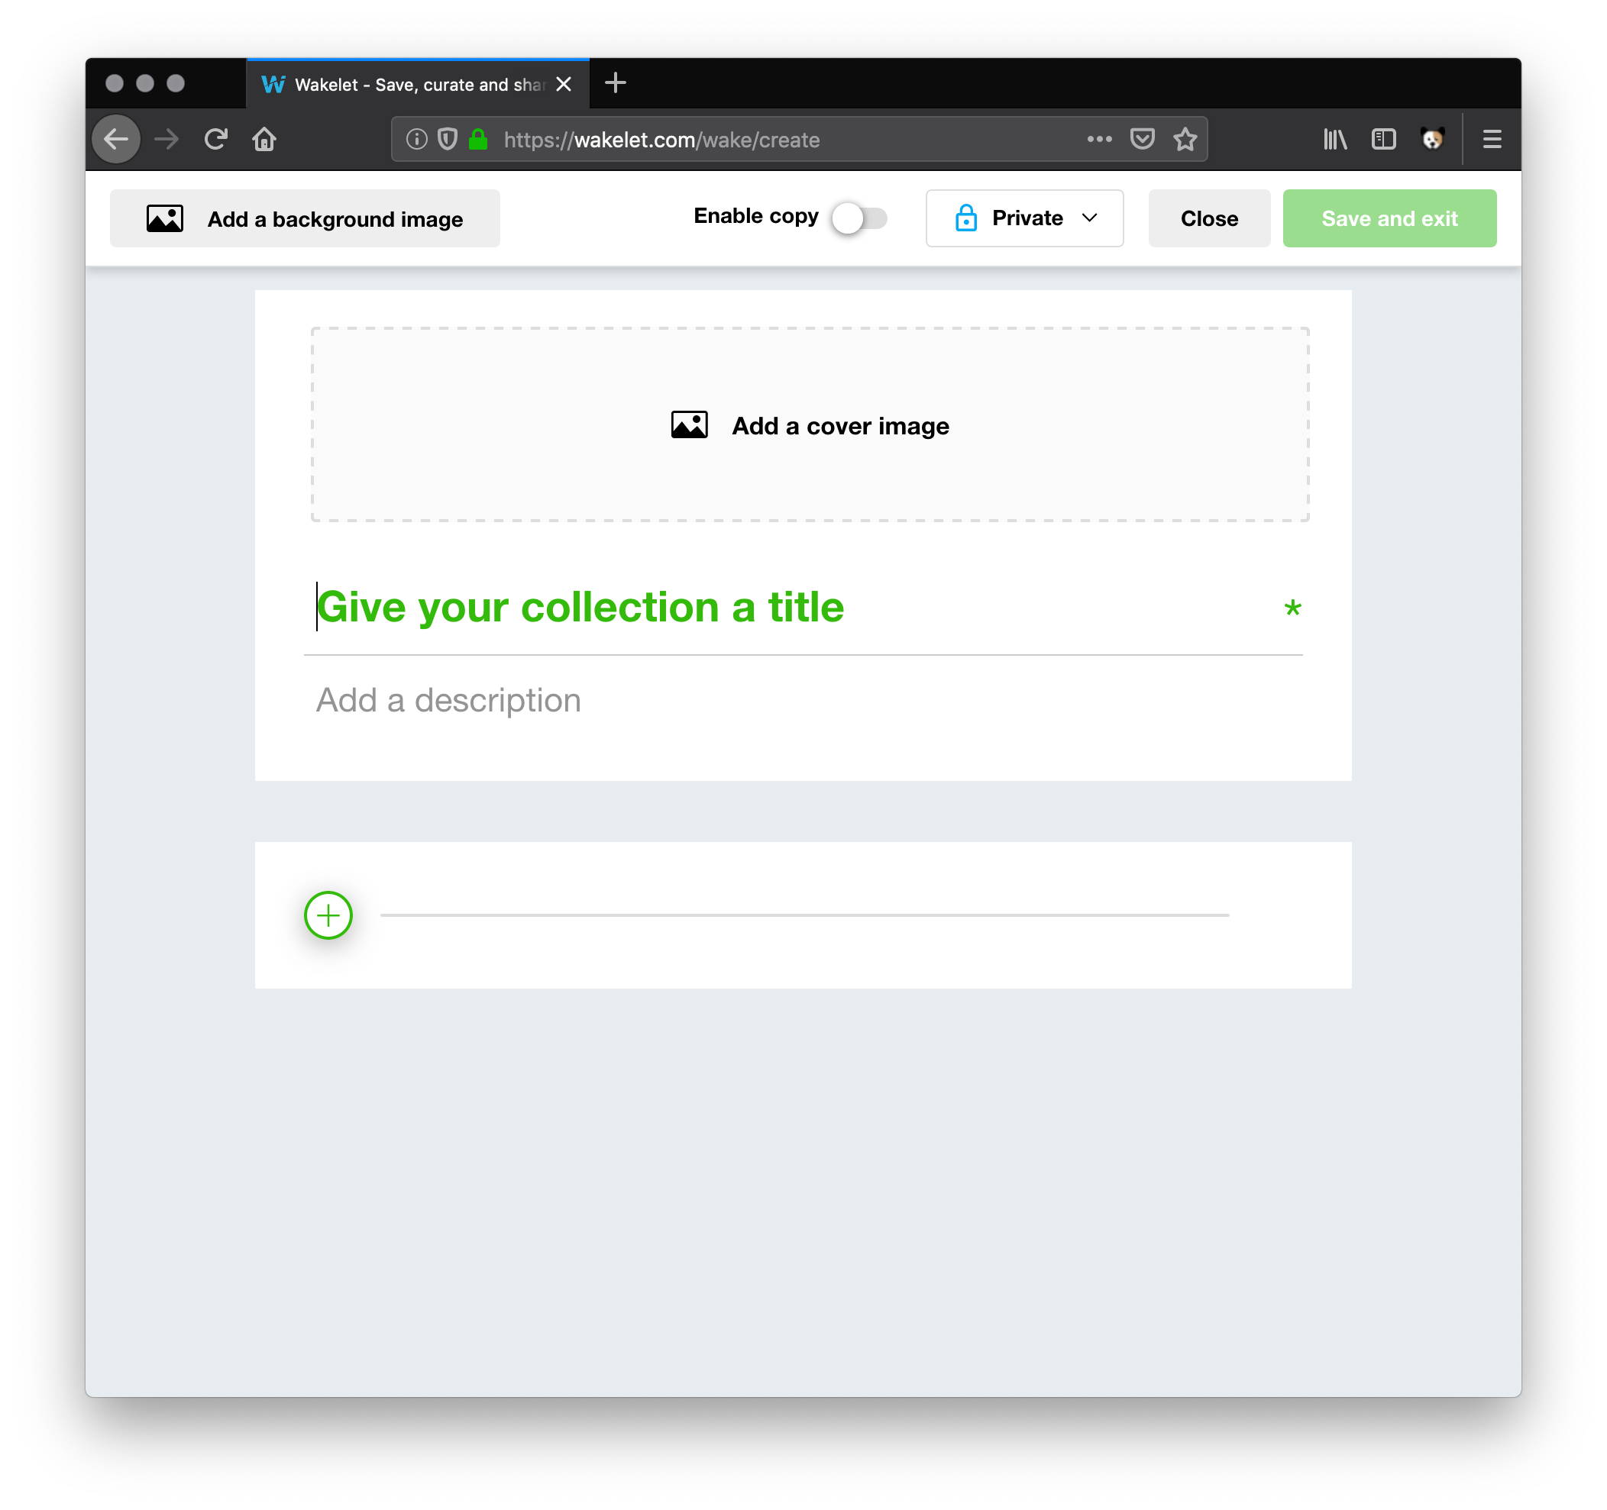
Stories with Wakelet – Creating a Collection
1. Create a new collection

Slide 53
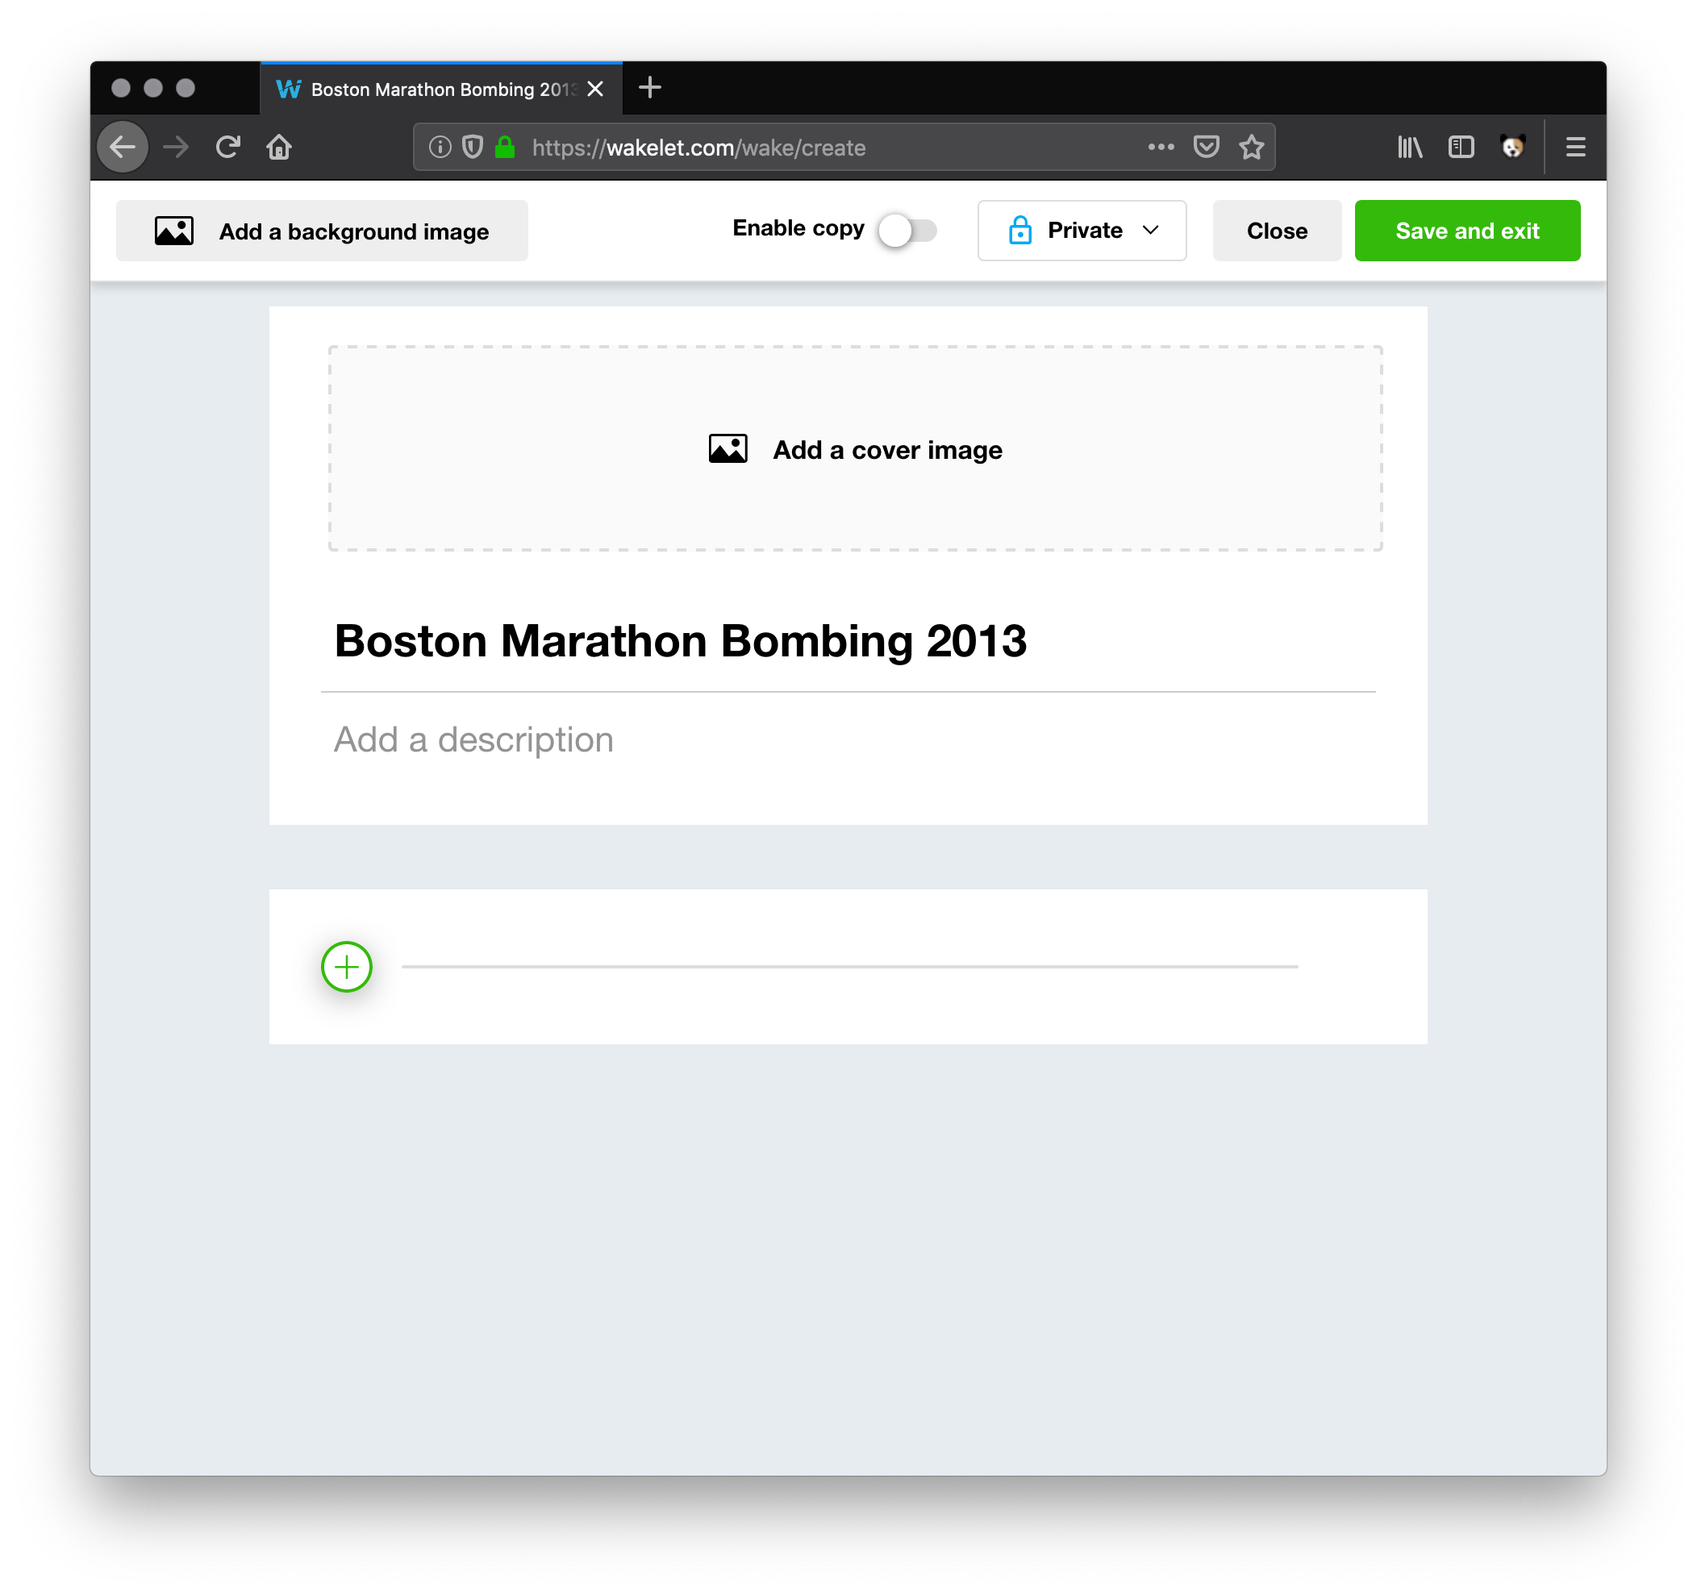
Stories with Wakelet – Titling the Collection
2. Give your collection the title of the Web Archive collection

Slide 54
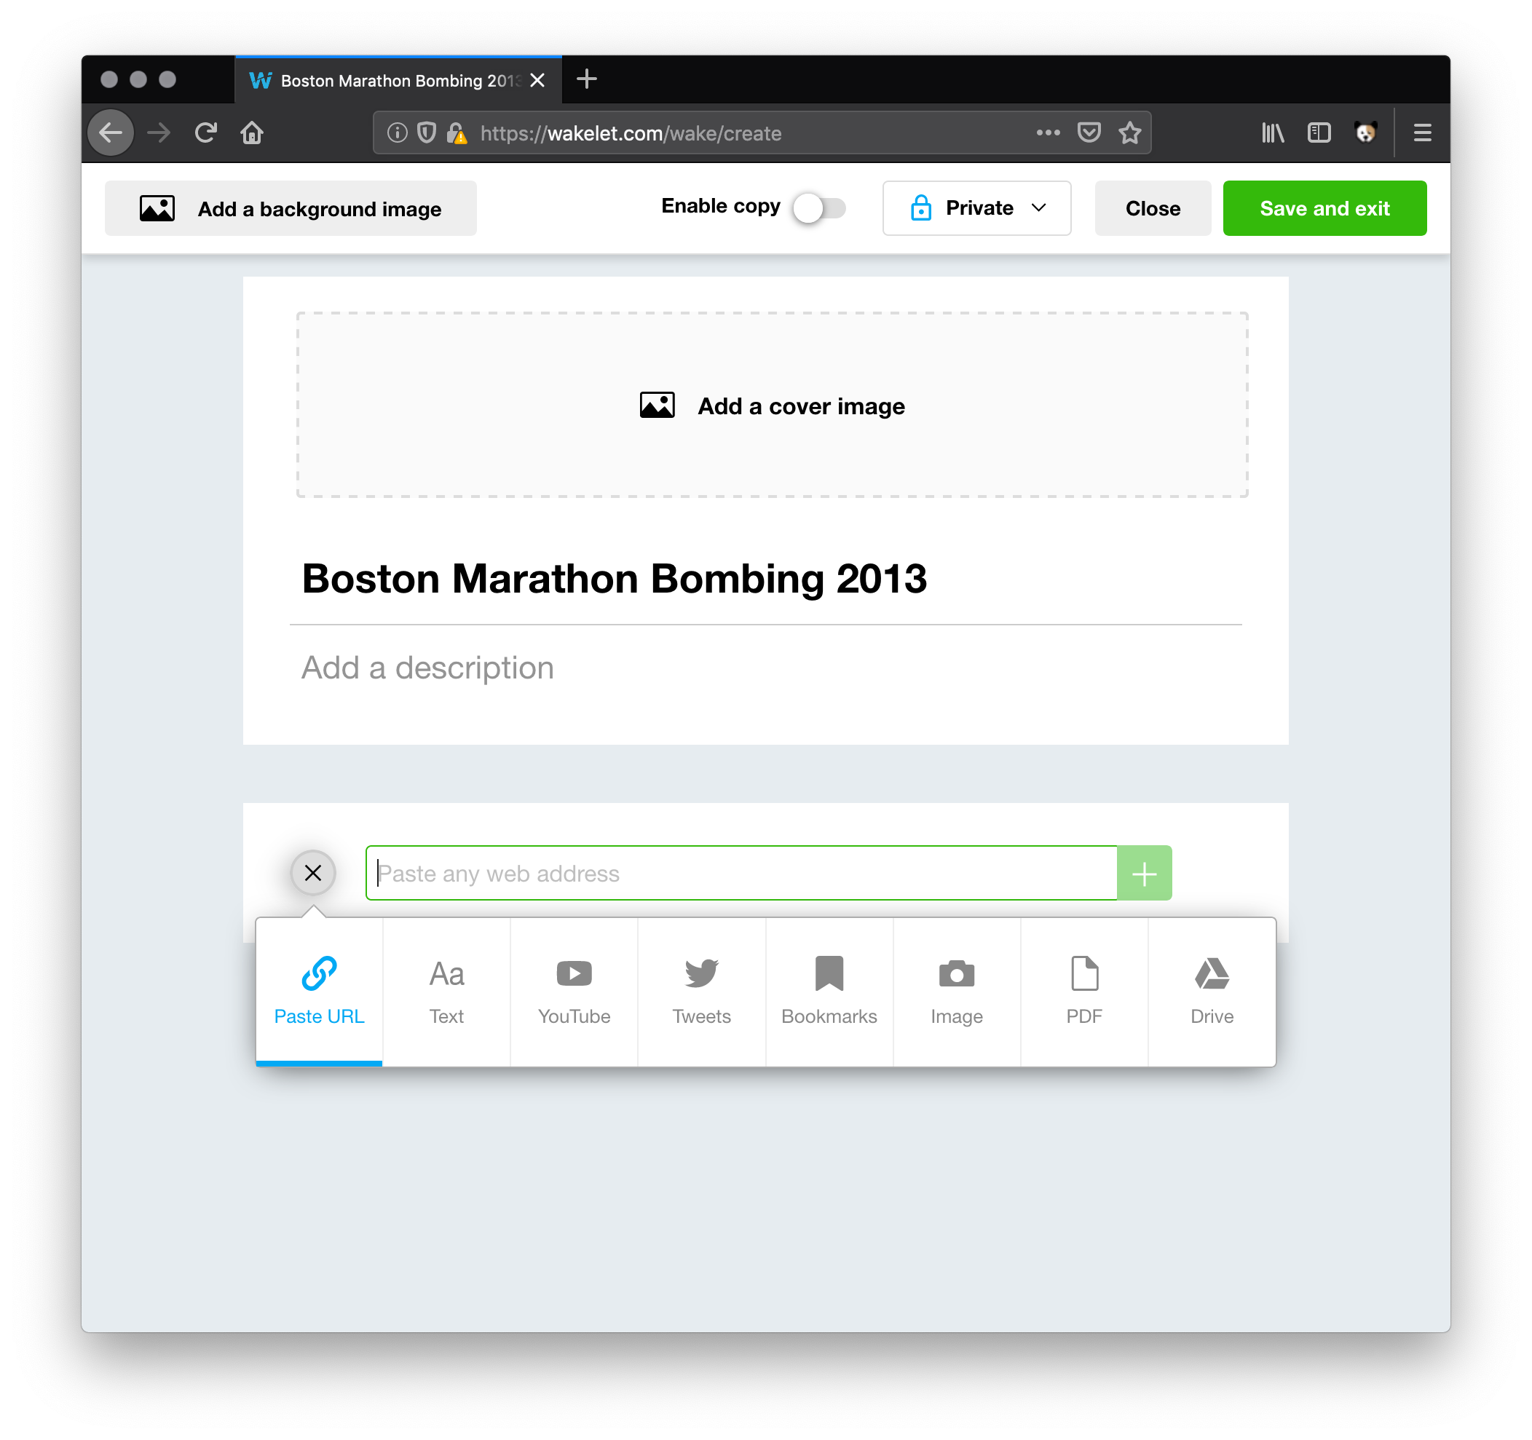
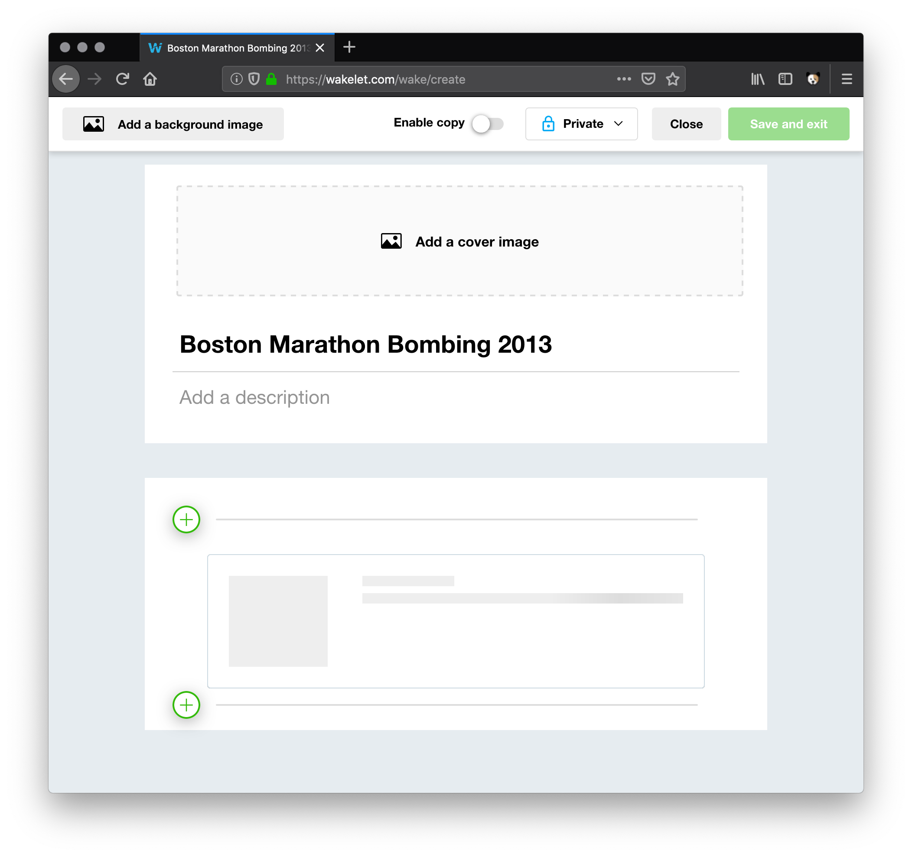
Stories with Wakelet – Pasting URLs
3. Paste the first URL from your story resources
4. Wait for the card to render
5. Repeat for all other URLs

Slide 55
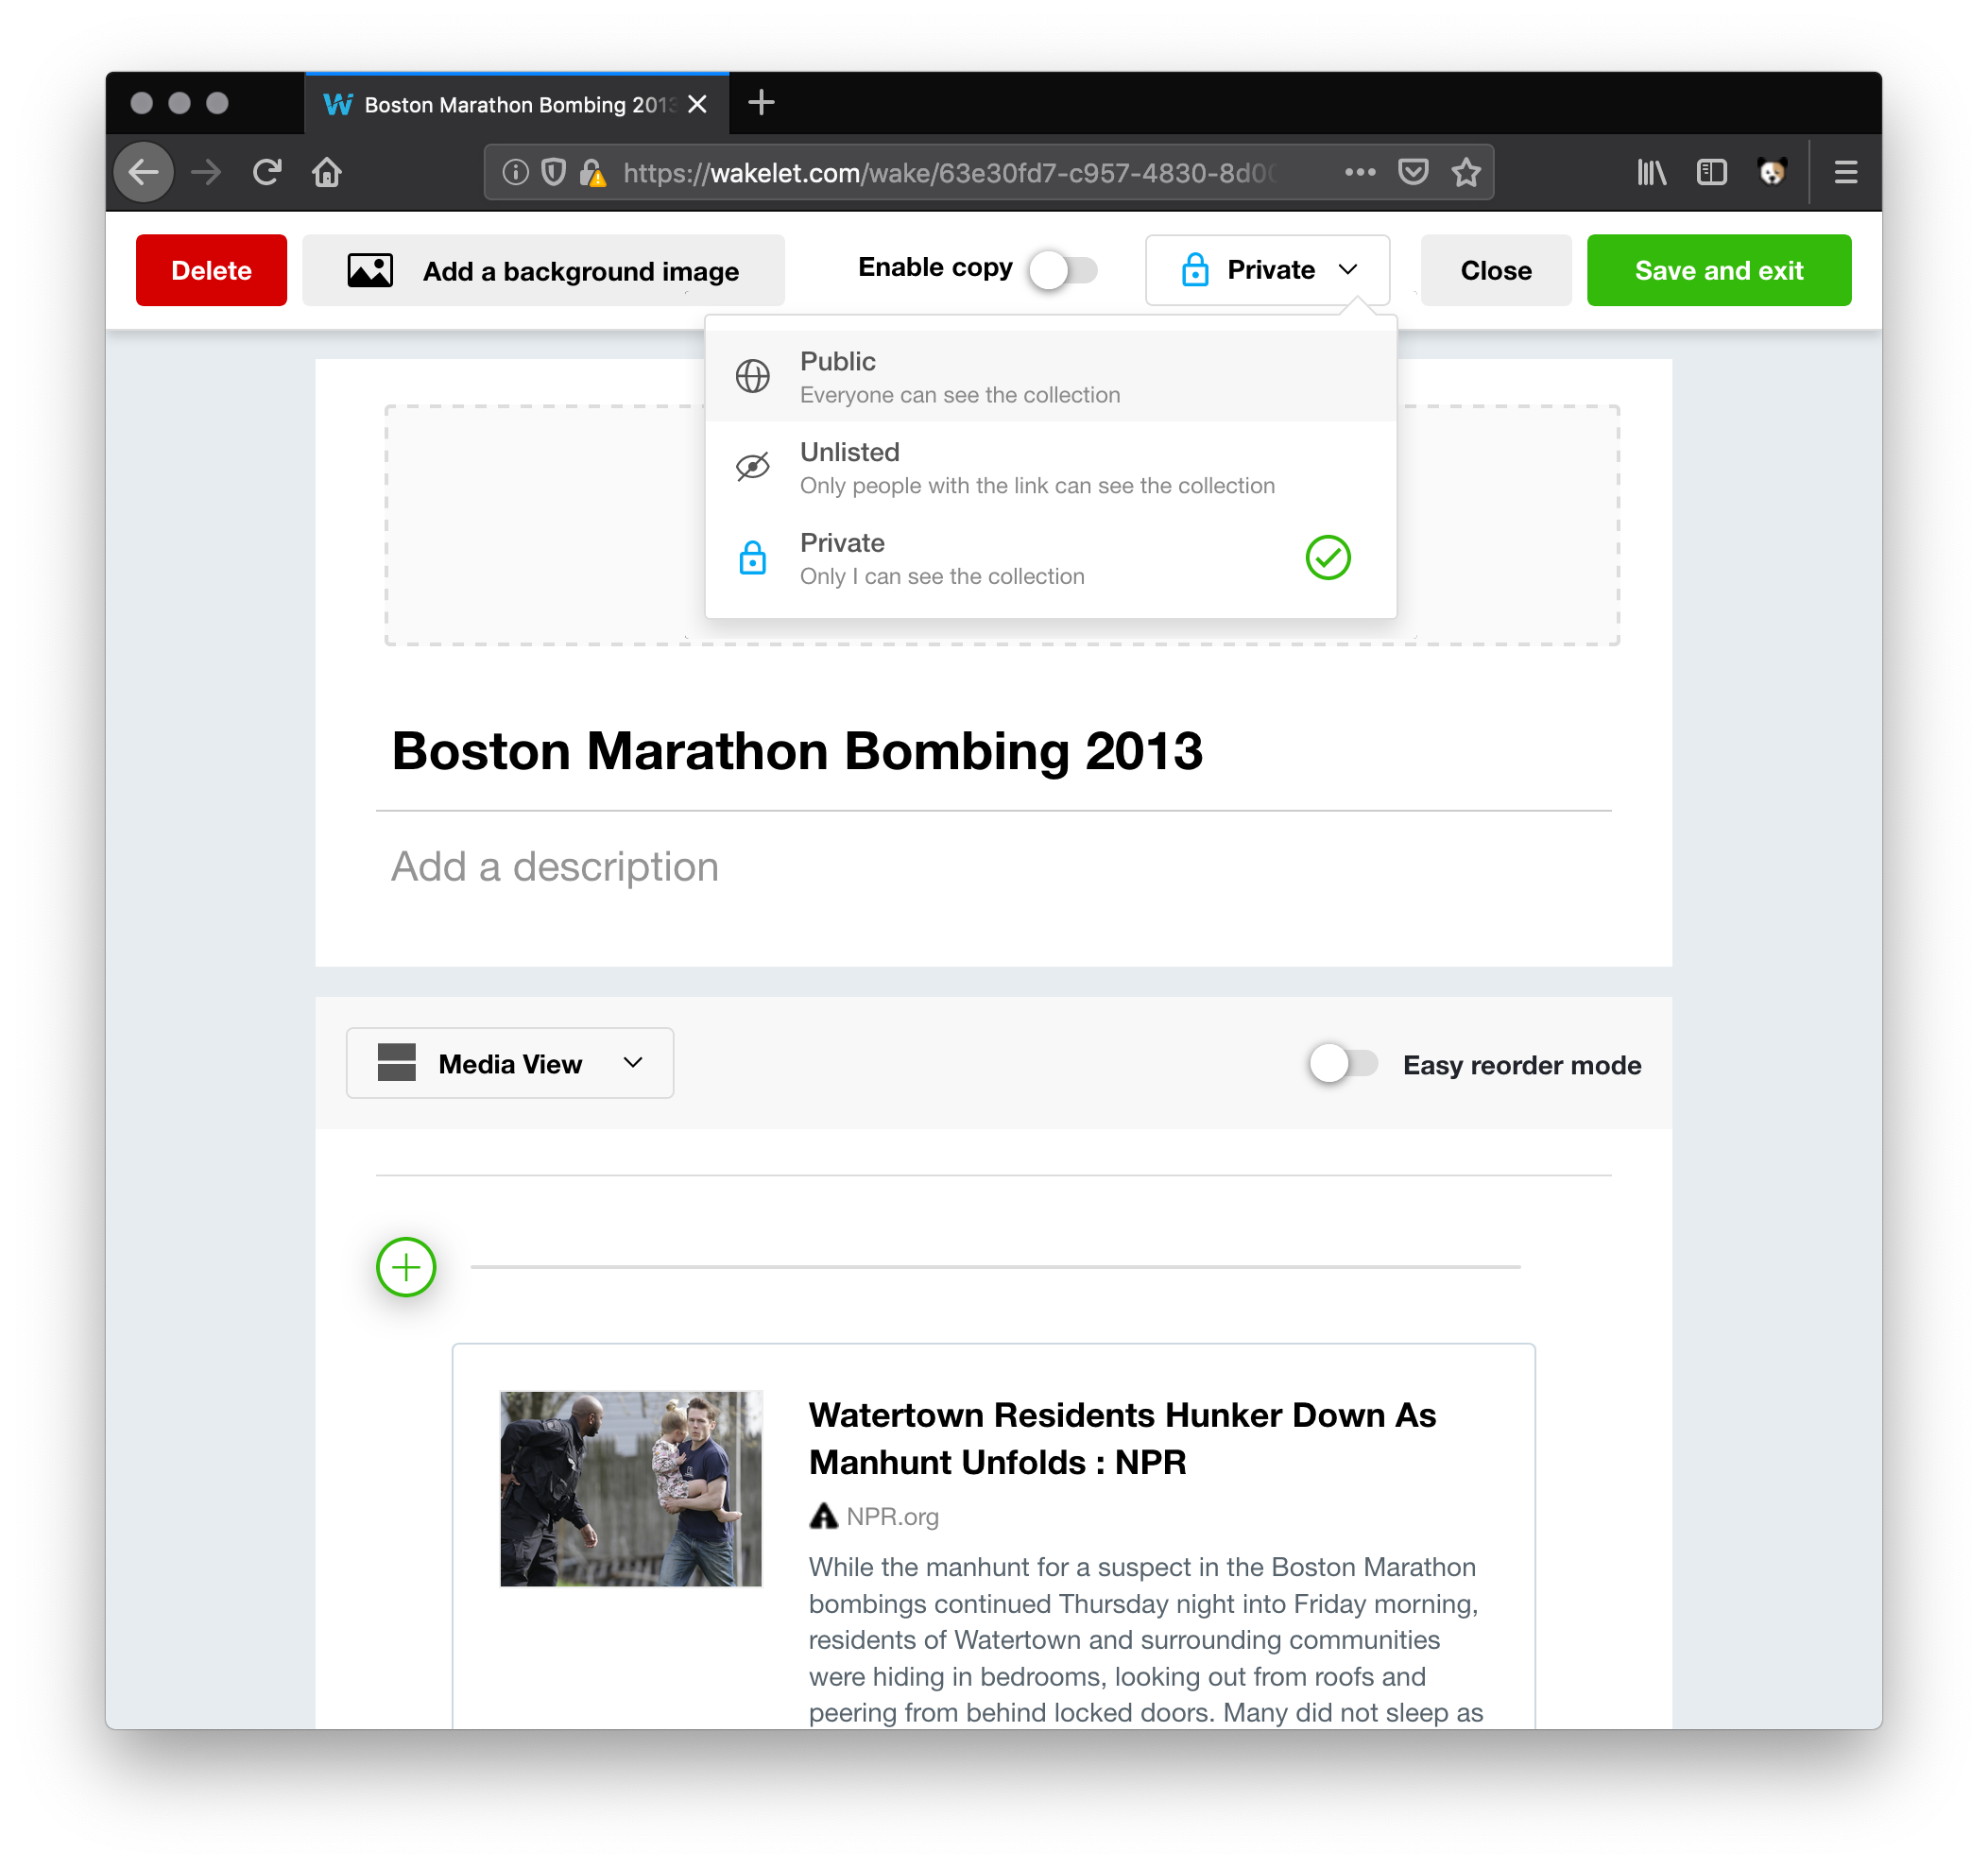
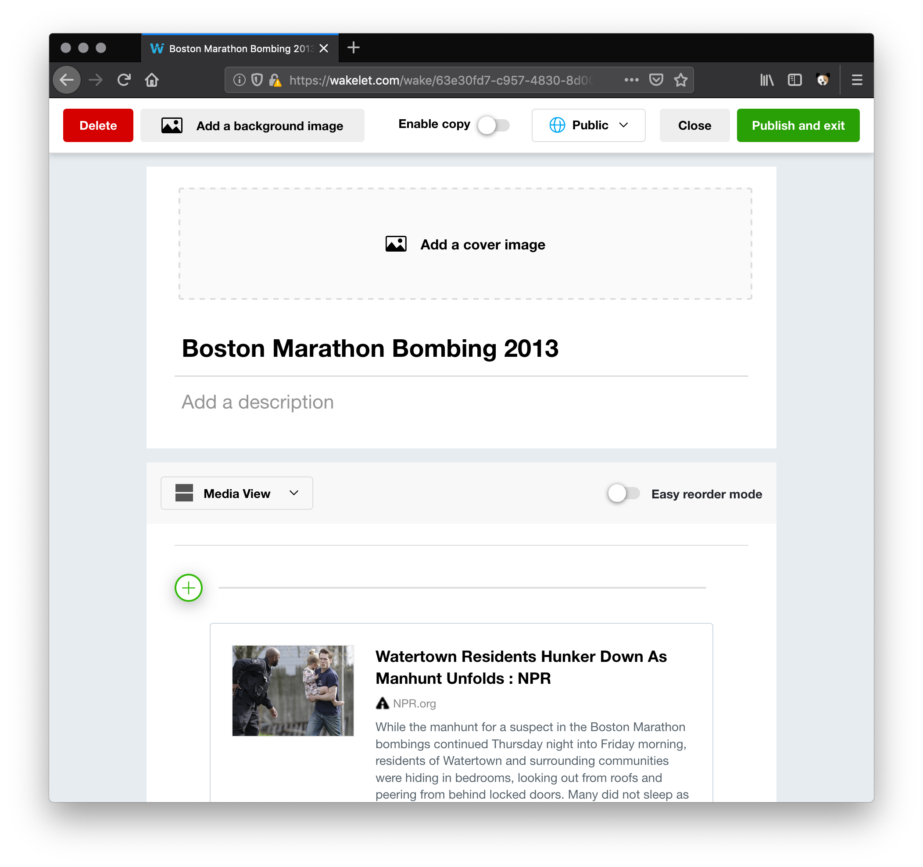
Stories with Wakelet – Saving the Collection
6. Click the drop down to change from Private to Public
7. Click Publish and Exit

Slide 56
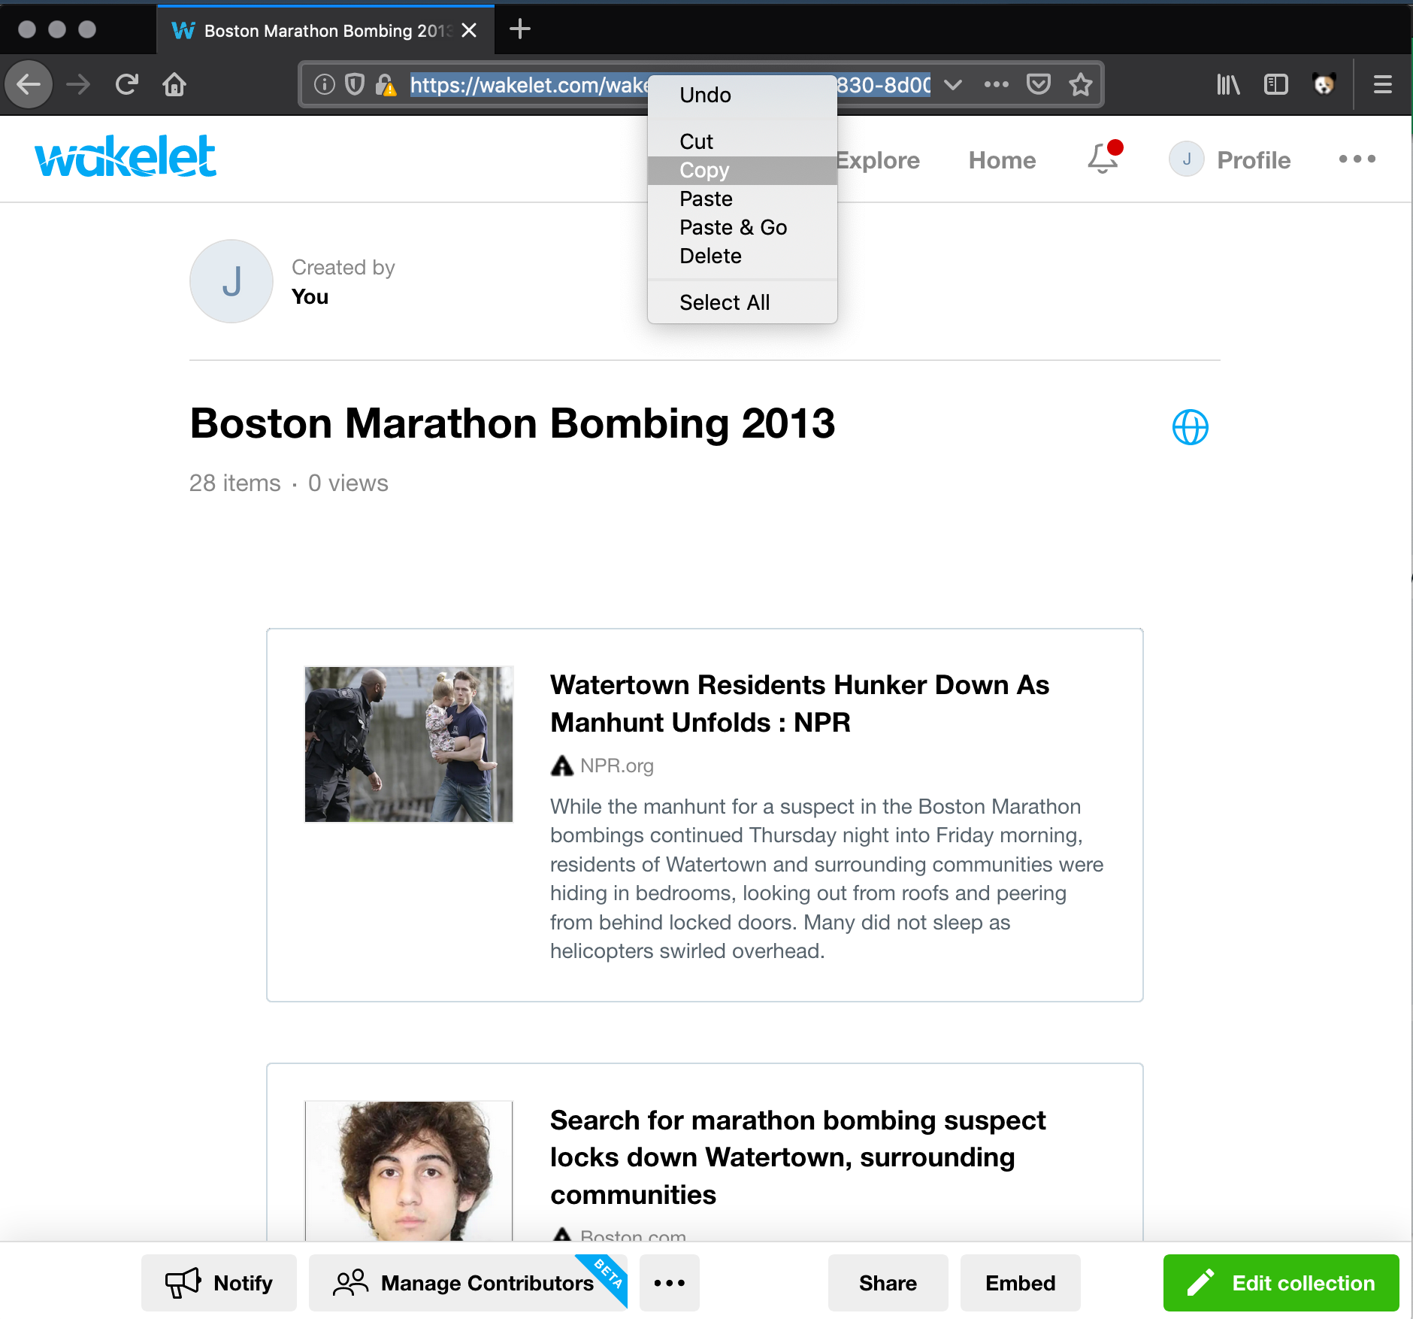
Stories with Wakelet – Sharing your story
After saving, the URL to your story is available in the browser. Copy this URL and share it via email, messaging, blogging, etc.

Slide 57
Problems with Alternative Platforms
These platforms do not reliably produce cards for mementos
These platforms do not produce consistently-size cards for mementos
Twitter Moments (not Tweets)
cards appear in Tweets, but not when gathered into a Moment
Listly
ChannelKit
eLink
Pearltrees
Symbaloo
Flockler
Pinterest
Flipboard
Juxtapost
Scoop.it
A more in-depth analysis on Storytelling tools is here:
https://ws-dl.blogspot.com/2017/08/2017-08-11-where-can-we-post-stories.html

Slide 58
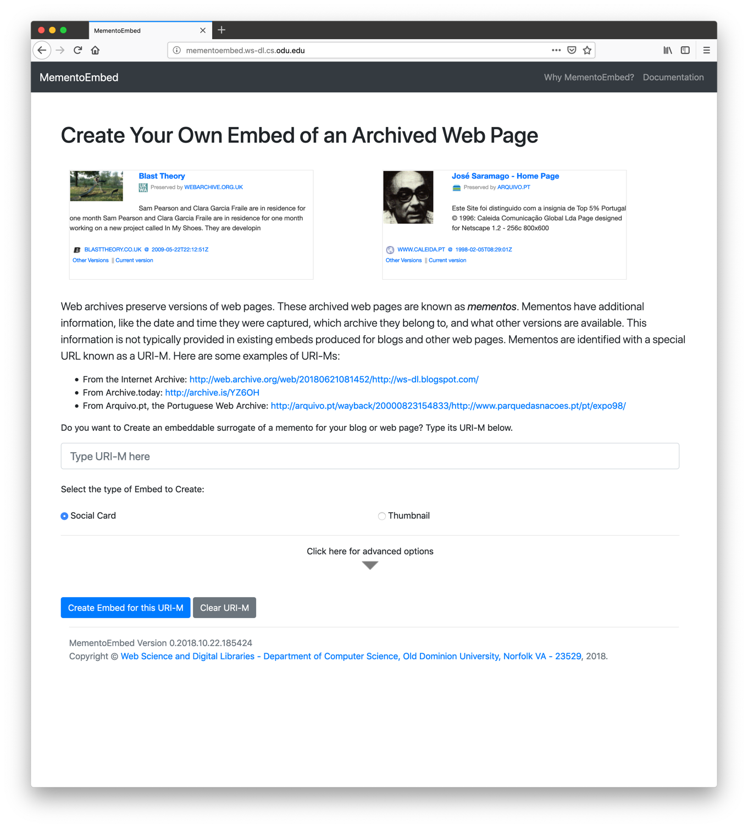
Introducing MementoEmbed cards
We created MementoEmbed because of the issues of generating reliable cards on other platforms
MementoEmbed allows us to make social cards for mementos
We can paste these cards into blog posts to make a story

Slide 59
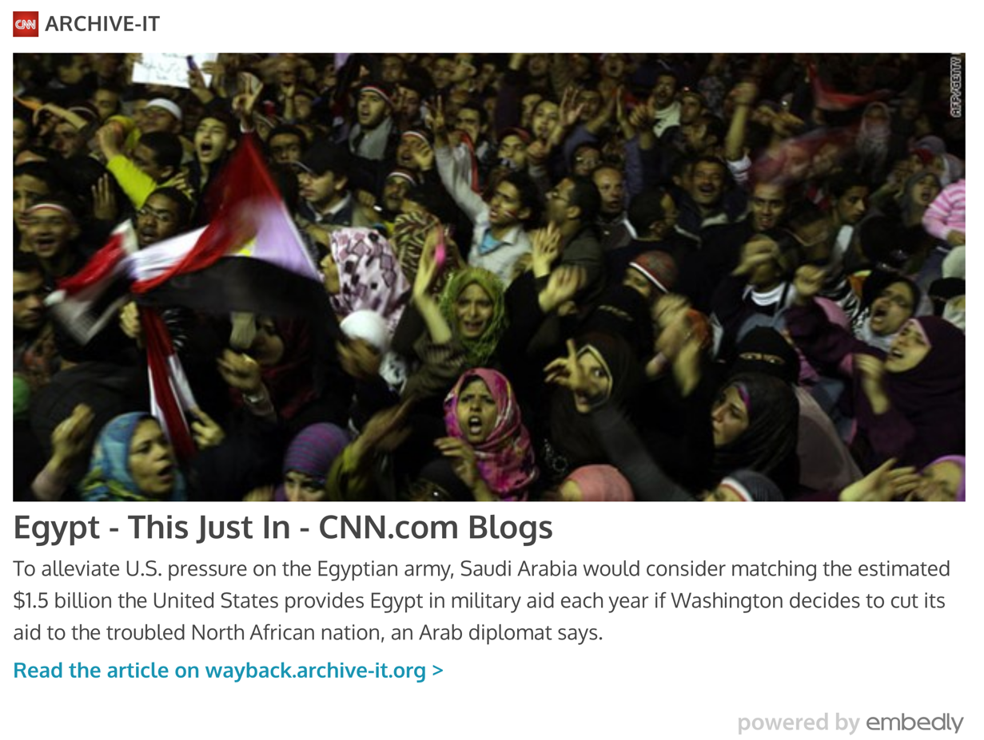

Why MementoEmbed cards?
Existing embed services confuse memento content, original resource identification, and archive identification
Some embed services, like Noembed and iframely, do not support web archives
For others, it appears as if the web archive is the author of the article:
Who wrote this article?
CNN? Archive-It?
Is this Fake News?
Should we be suspicious of this link?
A Memento visualized with Embed.ly
Why does Archive-It have CNN’s favicon?
The same Memento in visualized with embed.rocks
Is this a CNN article or an Archive-It article?

Slide 60


MementoEmbed Cards are Archive-Aware
Unlike social cards from other services, MementoEmbed cards are archive-aware.
MementoEmbed cards avoid the confusion created by cards from other services.
MementoEmbed cards contain the following for each memento:
the archive they came from
memento-datetime
links to other versions
original domain separate from the archive domain
title of the page
a striking image from the page
a text snippet
See:
https://ws-dl.blogspot.com/2018/08/2018-08-01-preview-of-mementoembed.html

Slide 61

Creating Cards for Your Story with MementoEmbed
Visit http://mementoembed.ws-dl.cs.odu.edu/
2. Paste in the first URL from your story

Slide 62


Creating Cards for Your Story with MementoEmbed
3. Click “Create Embed for this URI-M”
4. Wait for the card to generate

Slide 63


Creating Cards for Your Story with MementoEmbed
5. Copy the code from the box on the right
6. Paste it into the HTML panel in your blog, along with a <br> tag
7. Repeat for all other URLs from your story

Slide 64
Automatically Visualizing The Story

Slide 65

Introducing Raintale
Raintale uses MementoEmbed to generate raw HTML stories or publish them to services like Twitter
Raintale takes a text file consisting of the URLs for the story
This file could be generated by the select_high_quality command or other commands from the OTMT
This file could also be generated by you! You can manually select URI-Ms to insert into the story.
Raintale also has additional arguments for specifying:
The title of the story
The name of the person, organization, or algorithm that generated the story
The URL of the collection behind the story

Slide 66
Installing Raintale
Create a folder named raintale-working
Download the file docker-compose.yml from https://raw.githubusercontent.com/oduwsdl/raintale/master/docker-compose.yml and save to that folder
Open a terminal
Change to the directory you created in step 1
Type the following command to start a shell for raintale: docker-compose run raintale bash
Run the commands on the following slides from that prompt

Slide 67
Using Raintale to Automatically Generate Story HTML
Run the following command: docker-compose run raintale tellstory -i story-mementos.txt --storyteller rawhtml --title "Occupy Movement 2011/2012” --collection-url https://archive-it.org/collections/2950 --generated-by "Collection Archivist” -o mystory.html
story-mementos.txt is the list of mementos
--storyteller rawhtml tells raintale to save the html of the story to a file
-o mystory.html tells raintale to save the html of the story to a file named mystory.html
--title is the title of your story
--collection-url provides the URL for the collection so your users can visit the larger collection
--generated-by allows you to specify the name of an individual, organization, or service that generated the story

Slide 68


After Pasting and Publishing, Your Story is Now on Blogger
1. Create a new blog post, title it, and copy/paste the content from mystory.html
2. Click “Publish” and then you can view and share your story

Slide 69
After Pasting and Publishing, Your Story is Now on Blogger
You specified the ”story by” using the --generated-by argument in Raintale

Slide 70
After Pasting and Publishing, Your Story is Now on Blogger
The ”Collection URL” comes from the --collection-url argument you specified in Raintale

Slide 71
After Pasting and Publishing, Your Story is Now on Blogger
Your mementos were visualized using MementoEmbed behind the scenes and became these cards

Slide 72

Preparing to Publish a Story on Twitter
Log into the twitter account you wish to use for your stories
In a separate tab or window, visit https://developer.twitter.com/en/apps
Click “Create an app”
Fill out the required fields on the form
Leave the “Callback URLs” blank
Click Create

Slide 73

Preparing to Publish a Story on Twitter
Click the “Keys and tokens” Tab
Under “Access token & access token secret”, click “Create”
Leave the browser open and create a file named twitter-credentials.yaml
Create the following entries: consumer_key: XXXXXXX consumer_secret: XXXXXX access_token_key: XXXXX access_token_secret: XXXXX
Replace the XXXXX with the appropriate values from the “Keys and tokens” tab

Slide 74
Using Raintale to Publish a Story to Twitter
Run the following command: docker-compose run raintale tellstory -i story_mementos.txt --storyteller twitter --credentials_file twitter-credentials.yaml --title "Occupy Movement 2011/2012” --collection-url https://archive-it.org/collections/2950 --generated-by "Collection Archivist”
story_mementos.txt is the list of mementos from the last step
you can even manually select your own mementos to tell a story and save them to a file specified by the -i argument
--storyteller twitter tells raintale to create tweets of the story
--credentials_file twitter-credentials.yml tells raintale to look for Twitter credentials in the file twitter-credentials.yml
--title is the title of your story
--collection-url provides the URL for the collection so your users can visit the larger collection
--generated-by allows you to specify the name of an individual, organization, or service that generated the story

Slide 75

Your Story is Now a Collection of Tweets and Replies
The first tweet contains information about the collection.
Each reply is an item from the story, in the order you placed them in the input file.
https://twitter.com/archive_stories/status/1123077635662200832

Slide 76
Your Story is Now a Collection of Tweets and Replies
You specified the title using the --title argument in Raintale

Slide 77
Your Story is Now a Collection of Tweets and Replies
You specified the ”story by” using the --generated-by argument in Raintale

Slide 78
Your Story is Now a Collection of Tweets and Replies
The ”Collection URL” comes from the --collection-url argument you specified in Raintale

Slide 79
Your Story is Now a Collection of Tweets and Replies
Using MementoEmbed behind the scenes, your mementos were broken down into titles, images, URI-Ms, and memento-datetimes to become these tweets.
Twitter does not always produce cards for URLs. This method surmounts that shortcoming.

Slide 80
Shutting Down Raintale
In the terminal, type:
exit
Shut down the Docker containers:
docker-compose stop
Remove the Docker containers:
docker-compose rm -f

Slide 81
Summary
We introduced social media storytelling
We demonstrated how to use these parts of the Dark and Stormy Archives Toolkit:
The Off-Topic Memento Toolkit
MementoEmbed
Raintale
We manually visualized stories using Facebook, Wakelet, and MementoEmbed/Blogger
We automatically visualized stories using Raintale, with outputs to Blogger and Twitter
We showed how to summarize and visualize a collection via social media storytelling

